Slide 1
Grey literature What, Why, How Helen Whittaker

Slide 2
What is Grey literature
Grey literature is resources and materials that are produced outside of traditional academic or commercial channels. Grey literature includes:
- Reports, government documents, working papers - Conference papers and proceedings - Dissertations and theses - Policy documents and guidelines - Clinical trials - Preprint articles - Social media

Slide 3
Why use Grey Literature
Grey literature can be more current than formally published research, such as articles and books which go through a lengthier peer review or editorial process.
It can identify forthcoming or more niche research.
Not everyone is able to publish with mainstream publishers. Grey literature provides researchers with alternative methods of publication.
It can enable you to find research not found in your database searches.
As with any resource, assess for reliability, currency, potential bias and authority. Keep a record of what you find and where you searched.

Slide 4
Information tools to help you find Grey Literature
There are a number of information and research tools that can help you find grey literature.
Key tools include:
- Databases
- Library Catalogues
- Organisational websites
- Government websites
- Statistical websites
- Internet search engines, eg Google Scholar https://scholar.google.com

Slide 5
Specific resources to find Grey literature: Conferences Theses

Slide 6
Conference proceedings - what are they
Conferences are a major source of current research. At conferences, researchers present a paper on their research.
There is no standard way to publish them. They may be presented as a brief online paper, as articles within a journal, or as books of conference proceedings.
Sometimes they are not published and may only be available from the authors.
Conferences can also be called meetings, seminars, congresses or workshops.

Slide 7
Conference proceedings - how to find them
Web of Science - access from the Databases list on the library webpages
- A multidisciplinary database, contains Conference proceedings. Refine your search results from the list of document types on the left of your results.
Google Scholar - https://scholar.google.co.uk/ - includes conference papers. Search by keyword and add the word conference to your search and a date if needed, eg conference diabetes
Databases - Other databases include some conference papers. Search by keyword and add the word conference, eg “climate change” and conference - Go the Course resource webpages for relevant databases for your subject area https://www.brookes.ac.uk/library/resources-and-services/course-resource-help

Slide 8
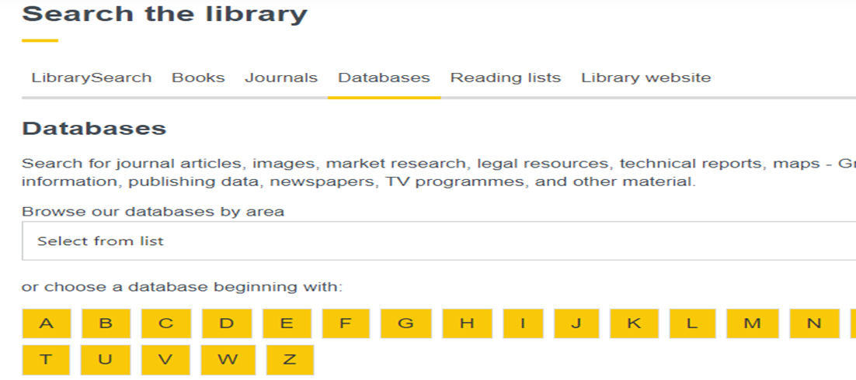
To access Web of Science, go to the library homepage at www.brookes.ac.uk/library
Select Databases above the search box
From the A-Z list, select W
At the next screen, select Web of Science
Click Search Collection…

Slide 9
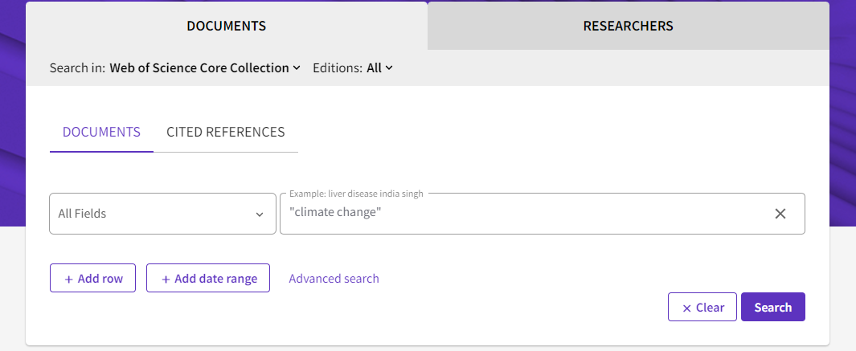
Type your search into the search box
Refine your results from the list of options, eg by Document type and Proceeding paper

Slide 10
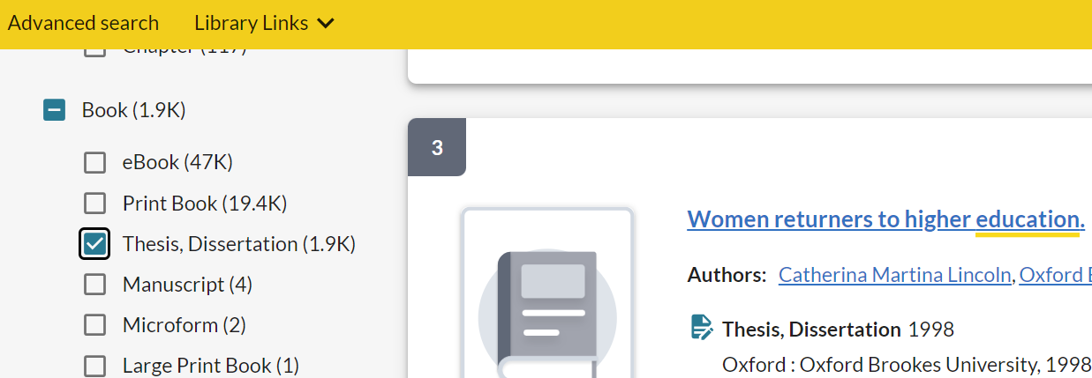
Theses
Theses are extended pieces of academic writing detailing an author’s research findings. They may not be formally published but can be available through open access sources and repositories.
LibrarySearch – www.brookes.ac.uk/library includes Oxford Brookes theses. Carry out a search and refine your results by selecting ‘Thesis, Dissertation’ below ‘Format’ and ‘Books’.

Slide 11
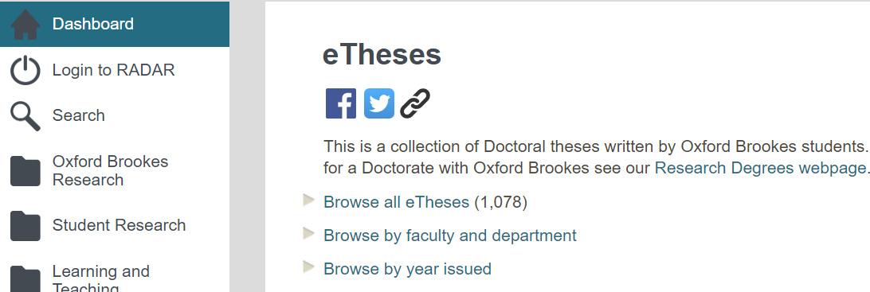
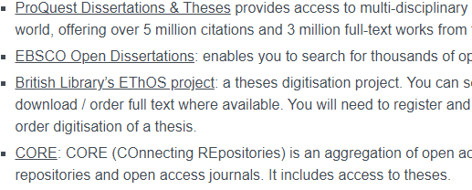
Theses
Our Institutional Repository RADAR https://radar.brookes.ac.uk/radar also contains details of our online theses: Select ‘Student Research’ and ‘eTheses’. Browse all or by faculty, department, year.
The Library’s Theses webpages contain links to a number of resources to help you find worldwide theses, eg ProQuest Dissertations, Ebsco Open Dissertations https://www.brookes.ac.uk/library/resources-and-services/for-researchers/theses

Slide 12
Preprint articles Policy documents and guidelines Government, Organisational, Statistics resources

Slide 13
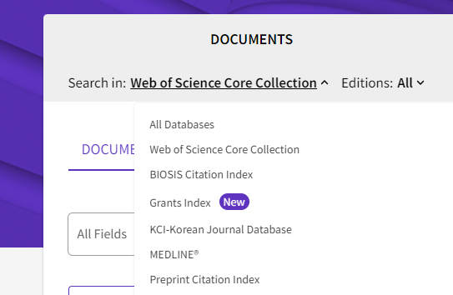
Preprints
A preprint is a full draft research paper that is shared publicly before it has been peer reviewed, enabling researchers to share their results quickly and freely.
Examples of preprint services include:
OSF Preprints – access to preprints in a range of subjects: https://osf.io/preprints
Preprints - a multidisciplinary preprint platform: https://www.preprints.org/
SSRN - multidisciplinary platform, with preprints: https://www.ssrn.com/index.cfm/en/
Web of Science database includes the Preprint Index
Details of more preprint services are on our webpages: https://www.brookes.ac.uk/library/resources-and-services/for-researchers/keeping-up-to-date#articles

Slide 14
Government and Organisational documents
Governments, Departments and Organisations can provide access to policy documents, standards, guidelines, consultations, legislation and statistics.
Use internet search engines to find relevant resources, eg Google advanced, to search for topics and type of document https://www.google.co.uk/advanced_search
Examples of specific sites:
- GOV.UK - the UK government’s website providing access to government departments, services and information https://www.gov.uk/
- UN E-Government Knowledgebase – provides links to worldwide government websites https://publicadministration.un.org/egovkb/en-us/Resources/Country-URLs

Slide 15
Policy documents and guidelines
Policy Commons https://policycommons.net/ - Provides access to policy reports, analyses and working papers from thousands of worldwide policy organizations
Register to access the content.
Internet searching
- If you need to use the internet, google advanced search provides more of a structure to frame your search https://www.google.co.uk/advanced_search
Trip database – healthcare https://www.tripdatabase.com/ - Includes health related guidelines, policy documents, patient leaflets

Slide 16
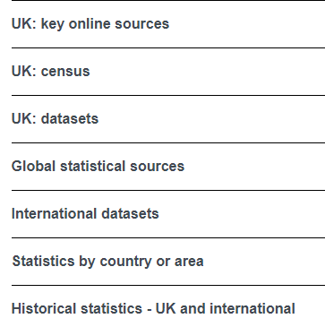
Statistics sources
The library’s Statistics webpage provides UK and international sources: https://www.brookes.ac.uk/library/collections/statistics
Including UK sources & datasets, Global statistical sources, International datasets, Statistics by country or area
Key UK sources:
Office for National Statistics (ONS) - https://www.ons.gov.uk/ Official statistics on a wide range of topics
Gov.uk: Statistics https://www.gov.uk/search/research-and-statistics provides access to statistics from UK government departments and other agencies and public bodies.

Slide 17
News sources Social media Health related grey literature resources

Slide 18
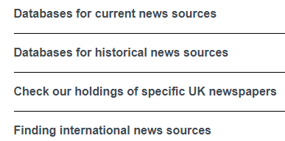
News sources
News sources are not considered as grey literature in some subjects but they can be useful sources for finding it, highlighting new research, reports or policies.
The library’s News source webpage provides useful links: https://www.brookes.ac.uk/library/collections/news-sources
There are two key databases which provide access to news sources, access and guides are available from the link above, via ‘Databases for current news sources’.
- Factiva is an international news database covering national and local newspapers, web sources, trade and professional journals and company financial details.
- Lexis+ is primarily a legal database which includes a collection of UK newspapers, broadsheets, tabloids and regional sources.

Slide 19
Social Media
Social Media such as blogs, social networking sites, email discussion lists can be useful sources of grey literature as well as networks for scholarly collaboration.
Examples include:
ResearchGate: https://www.researchgate.net/ academic social network for science and research. Connect, collaborate, find scientific publications Academia https://www.academia.edu/ find new research, track impact, publish
LinkedIn https://www.linkedin.com/ Connect with professional community, find collaborative research X (formerly Twitter) social networking site to share news, ideas, research

Slide 20
Health research – grey literature resources
In addition to the sources already detailed, the following resources can be useful:
World Health Organisation https://www.who.int/ links to health topics, information by country, data, and publications
UK Health Security Agency Grey literature index https://ukhsalibrary.koha-ptfs.co.uk/greylit/
Social Care Institute for Excellence https://www.scie.org.uk/
The King’s Fund https://www.kingsfund.org.uk/ independent charity working to improve Health and Social Care
International Clinical Trials Registry Platform (ICTRP) https://trialsearch.who.int/
ClinicalTrials.gov https://clinicaltrials.gov/ information on clinical research studies

Slide 21
For further help contact your Librarian https://www.brookes.ac.uk/library/resources-and-services/course-resource-help

