Slide 1
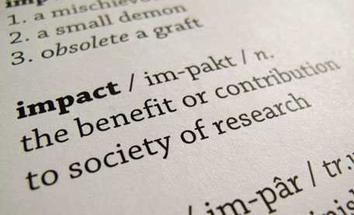
Research Impact

Slide 2
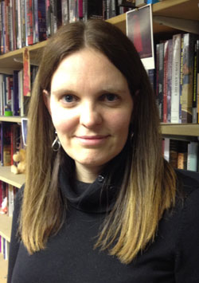
We take our impact seriously!
Prof Anne-Marie Kilday, PVC (Impact), Dean Humanities & Social Science
University strategy for impact
PVC remit not just about research

Slide 3
Impact is defined as…
… an effect on, change or benefit to the:
society
culture
economy
public policy or services
health
education
the environment
or quality of life
… beyond academia

Slide 4
Why make an impact…
Impact helps to demonstrate that research is important
That it is worth using and investing in
Benefits to your research
Impact helps to demonstrate that research is important
That it is worth using and investing in
Benefits to your research

Slide 5
Impact through the research process
Potential/Future impact (Pathways to Impact)
Knowledge Exchange (Maximising Impact)
Reporting on impact of previous research (REF Impact)

Slide 6
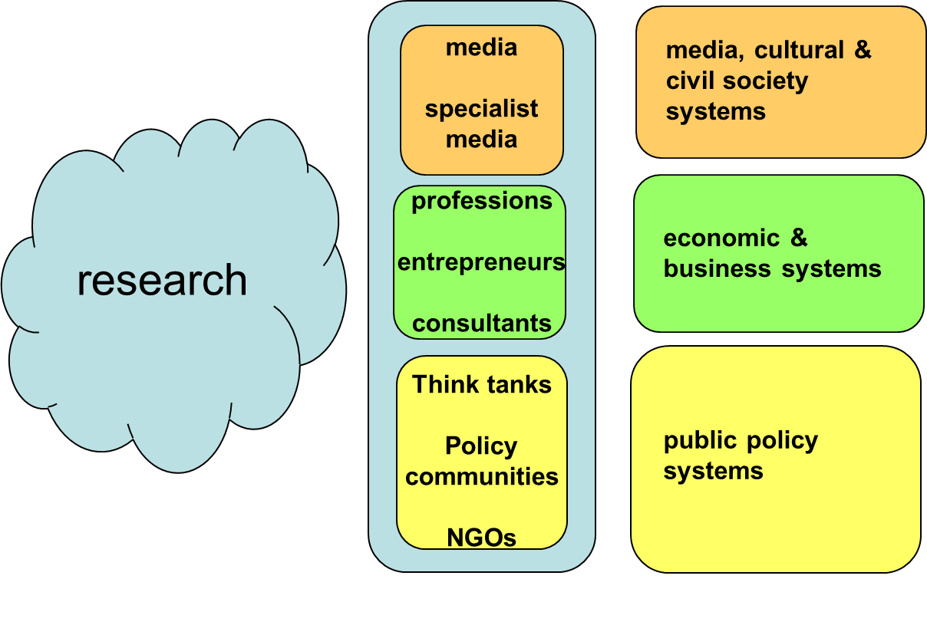
KE Routes
Impact ‘types’

Slide 7
Maximising impact….
Established networks and relationships with research users
Involving users at all stages of the research
Well-planned public engagement* and knowledge exchange strategies
Portfolios of research activity that build up reputations with research users
Retain evidence of when/how/where impact occurs

Slide 8
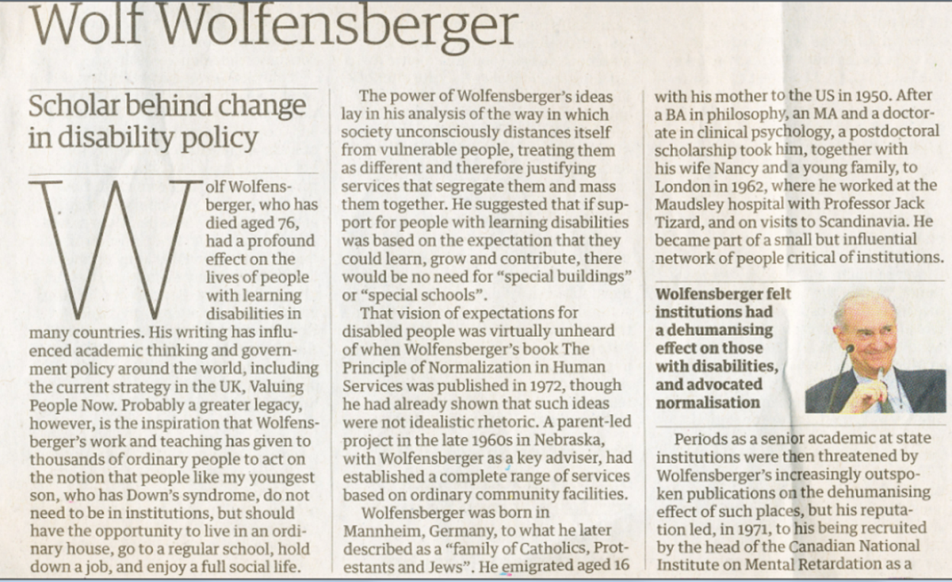
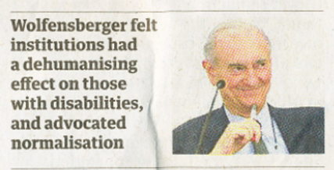
A short Exercise
What ‘impacts’ did his work have on society?
What insights does the obituary offer into how he achieved these impacts?
5-10 minutes

Slide 9
REF & RCUK
REF
Impact forms 20% of overall quality profile
Case studies & statement
Retrospective
(broadly) 1 case study per 10 FTE + 1 in UoA
RCUK
‘Pathways to Impact’ & Impact statement
Routes and mechanisms to achieve impact
Prospective
Each grant application

Slide 10
Four basic tenets of a ‘REF impact case study’*
Underpinning research undertaken at the submitting institution and be judged at least 2*
Impact must have occurred within the REF period, and be accompanied by supporting evidence.
The link between the research and the impact must be explicit
Impact does not travel
*Should the rules stay the same…

Slide 11
Our REF ‘impact’ case study submission
More than 40 case studies to 17 Units of Assessment (6975 total submitted across WHOLE SECTOR)
Hi-lights
The Duckworth/Lewis Method (Business & Management Studies)
Immunoassays for prenatal screening of Downs Syndrome (Biological Sciences)
Political Reception of Puccini (Music)

