Slide 1
Research at Oxford Brookes

Slide 2
Research at Oxford Brookes
This is going to be a brief run through of key areas to do with how research works at Oxford Brookes It will not be an exhaustive presentation and will mostly cover:
Structure of research management
Support for research
Areas of developing support
Opportunity for questions/comments and the like

Slide 3
Research structure - 1
Pro Vice-Chancellor, Research and Knowledge Exchange.
Alistair Fitt
Associate Dean Research and Knowledge Exchange. Strategy development and general research management
Louise Grisoni, Bus; Linda King, HLS; Gary Browning, HSS; Ray Ogden, TDE
All Departments have their own Research Leads
These report to the Head of Department
All Departments have their own REF Unit of Assessment Coordinators
These may be the same as the Research Leads and tend to only exist in the REF build-up periods

Slide 4
Research structure - 2
Research Offices in Faculties.
Each Faculty has a Research Manager. Pre-award support, REF, researcher support etc
Jenny Heaton, Bus; Jennie Cripps/Angela Robinson, HLS, Sally Wells, HSS; Bridget Durning/Bousmaha Baiche, TDE. They report to the Head of Administration and Support Services
Each Faculty has a Grants Officer. Pre-award support etc
These report to the Research Manager
Faculty Finance Offices. Post-award management
Have Business Support Managers and Business Support Officers specifically to look after externally funded research projects. Faculty Finance staff report to the Head of Finance and Planning

Slide 5
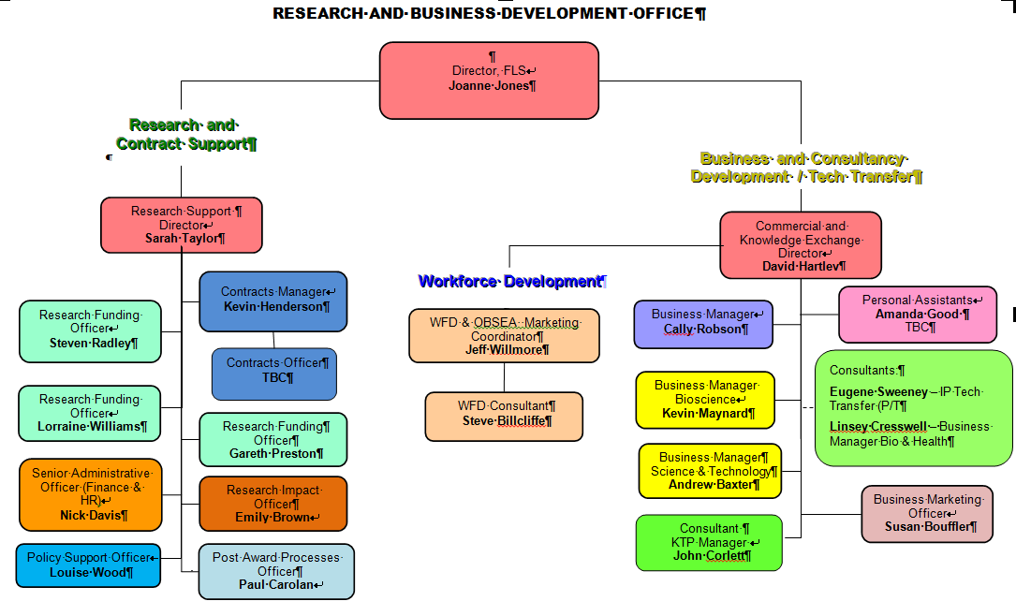
Research structure - 3

Slide 6
Research structure - 4
Researchers
Undertake PDRs but usually also have a Personal Research Plan
This usually covers a five year period and is reviewed every year
The first two years tend to be very detailed
The remaining years are increasingly vague and are worked up as time moves on
Internal money
The Pro V-C Research has funding from QR to allocate through the Central Research Fund (CRF)
This is usually to kick-start of finish something and is meant to lead to an outcome (a bid to an external funder, an output etc)

Slide 7
Research Systems - 1
pFACT
Exists NOW and is an external service used to cost research applications and manage workflow to approve bids
It has a limited shelf-life and we are trying to find how to replace
Converis (CRIS)
Is being formally launched in February 2015
Holds staff data from HR; output data; will hold project data (both internally and externally funded). Is an external service
Arkivum
Data archiving system, copies encrypted data to tape, which is backed up and preserved in three separate places
Just about to start an trial in two research groups in HLS, then to spreads across the Faculties on a pay-per-terabyte basis. Is an external service

Slide 8
Research Systems - 2
Research Professional
Exists NOW and is a subscription service that holds data on funding opportunities for research
Also has a news and views section
BEiTSY (Brookes Evidence of Impact Tracking System)
Is being developed internally – Emily’s talk will make it clearer why a system is needed

Slide 9
Research – what do all these people actually DO? - 1
Support bids for funds
2013-2014, the University bid for £24.7M research projects (275 indiv bids) and won £4.7M (77 indiv bids)
What does bidding for funds mean?
Asking funders to support a researcher’s programme of work. Usually means:
Application form, including budget
Case for support
Justification of Resources
Support letters from partners
Agreement for the time involved
All to the particular funder requirements and EVERY FUNDER HAS DIFFERENT REQUIREMENTS

Slide 10
Research – what do all these people actually DO? - 2
Support bids when awarded
2013-2014, the University had £3.5M through its audited accounts
This is comprised of many different grants from many different funders, all with their own audit and financial requirements
Each one will have required a contract to have been negotiated with the funder
Some will need interim reports
Staff will need to have been appointed as Research Assistants
Equipment bought, consumables consumed, travel undertaken
All the other things that research generates
Managing the programmes of work:
Staff employed on projects – their support, development etc
Outputs from Research: research data, outputs, Intellectual Property

Slide 11
Research – what do all these people actually DO? - 3
Ethics processes
Any research that involves human participants must have the appropriate research ethics approval
Research involving human participants is undertaken by many different disciplines in a broad range of settings. While some issues are specific to professional groups, all research should be guided by a set of fundamental ethical principles to ensure the protection of human participants.
For staff and PhD students this is via the University Research Ethics Committee
Undergraduate and Masters students research ethics review is undertaken at Faculty level.
Main considerations
to ensure that the dignity, rights, safety, inclusivity and well-being of all participants are given primary consideration
To ensure the safety of researchers, especially those working alone in the field

Slide 12
Research – what do all these people actually DO? - 4
Support for Visiting Researchers
The REF
All the other things that research generates
Reading, reviewing, writing and responding to policy
Marketing, newsletters
Supporting networks
Research-related events
Speed-dating (getting researchers together to see where synergies may lie)
Dealing with things that go wrong
Etc etc etc

Slide 13
Research ExcellEnce FrAmework
Assess quality of research in the UK
Takes place every 5-6 years
Allocates funding against a quality profile based on subject area (Unit of Assessment) NOT based on Departments, or individuals.
4* world leading; 3* world excellent; 2* internationally recognised; 1* national; u/c unclassified (not research or data judged to be missing)
 | 4* | 3* | 2* | 1* | u/c
RAE2008 | 8% | 26% | 44% | 20% | 2%
REF2014 | 13% | 42% | 37% | 7% | 1%

Slide 14
REF data
 | REF2014 | RAE2008 | RAE2001
Income | £21,370,061 | £23,331,677 | £11,851,427
Doctorates awarded | 252 | 245 | 188
Staff in FTE | 269.49 | 226.03 | 256.40
QR money allocated | ? March 2015 | £4,280,000 in 1st year | £2,741,000

Slide 15
The REF – so what?
REF quality profile gives QR money
Percentage of 4* and 3* (weighted as 3x4* and 1x3*) x FTE returned x quantum for the Unit of Assessment (all 36 have different quantum)
BUT the above is what applied to RAEF2014
We have no idea if it will be applied to the outcome of REF2014
QR money
A percentage goes to OBIS and LR a year to support research
60% goes back to the Faculties to spend to support research (each Faculty does this differently but they have to agree their plans with Alistair)

Slide 16
Research STUDENTS
Research students
Supported through ASA so treated as students, rather than staff or researchers BUT
Research Data Management Policy applies to research students as well as staff
Want them to deposit their outputs/theses on RADAR
Completions count in the REF
Very difficult to get external funding to support research students these days
Graduate College just set up, to try to pull together students support mechanisms and get more of a sense of cohort

Slide 17
Future Areas of development
Research data management
Is Policy in place
Is Operational Plan in place
Still areas of development – see this as constantly evolving area, where we aim to get better but will never be done
Open Access
Need to meet HEFCE requirements for the next REF. These need to be in place by 31 March 2016 so as to take effect on 1 April 2016
Impact
Emily will cover

