Slide 1
Within CLASS: an embedded curricular approach to the Careers and Library Audit of Student Success in Geography
Charlie Brampton, Wes Fraser,
Pete Smillie and Helen Walkington

Slide 2
Overview of this session
What is CLASS?
Background - Why did we create it?
Bitesize approach - How does it work?
Auditing - the questions
Initial results
Next steps
Notes:
CLASS (Careers and Library Audit of Student Success) is a collaboration between Geography, Learning Resources and Careers.
The project involved undergraduates completing a self audit questionnaire to rate core skills in information literacy and career readiness in their first and second years. By repeating the audit in the second year, staff and students can monitor any progress that has occurred.
Throughout the two years, colleagues from the Library and Careers embedded targeted, bitesize skills sessions into compulsory geography modules. These sessions formed part of the timetabled sessions for modules, so students could clearly see the relationship between them and their assessed work.
The project team wanted to break down the perceived barriers between ‘skills for my assignments’ and transferable ‘employability skills’, which is why the involvement of both the Library and Careers is critical.
This session will explore the findings from the CLASS project and discuss what happens next. Participants will hear about preliminary results of the audit and have the opportunity to consider adapting the CLASS audit for work with their own students.

Slide 3
Background
Lecturers and librarians teach students research skills for their assessments but can/do they apply these more widely e.g. when researching jobs?
We wanted to get students to reflect on their own skills, explore where they’d like to improve - and to actively make the links with how this can help build their future careers
Regular bitesize skills sessions were created (and we signposted other Brookes services) to help students improve
Notes:
Skills developed within Geography viewed as central to graduate employment.

Slide 4
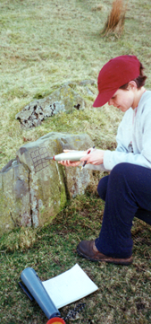
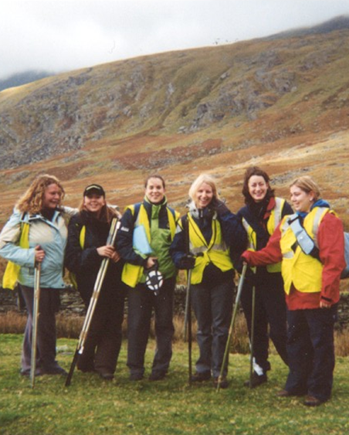
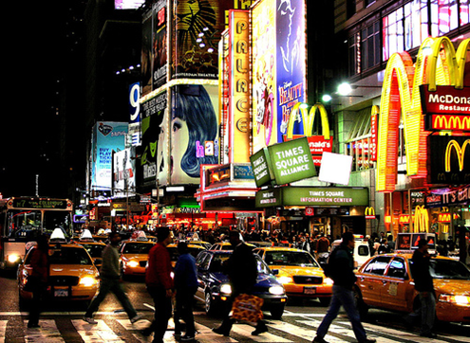
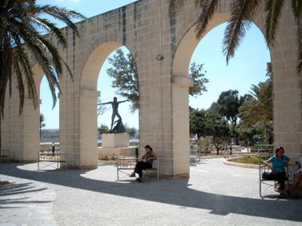
The bitesize sessions
Careers / library focus (balance varies across programme)
Embedded in modules
Geography has a Year 2 compulsory double module (research methods and overseas fieldwork)
Notes:
Sessions had a careers or library focus and were embedded in modules.
Geography lends itself well to this project because of the field trip and the associated skills development
The balance between library and careers varies across the 3 year degree course:
Year 2: Geography has a compulsory double module where students learn research methods and carry out fieldwork overseas in groups. Year 3 more specialised and fragmented

Slide 5
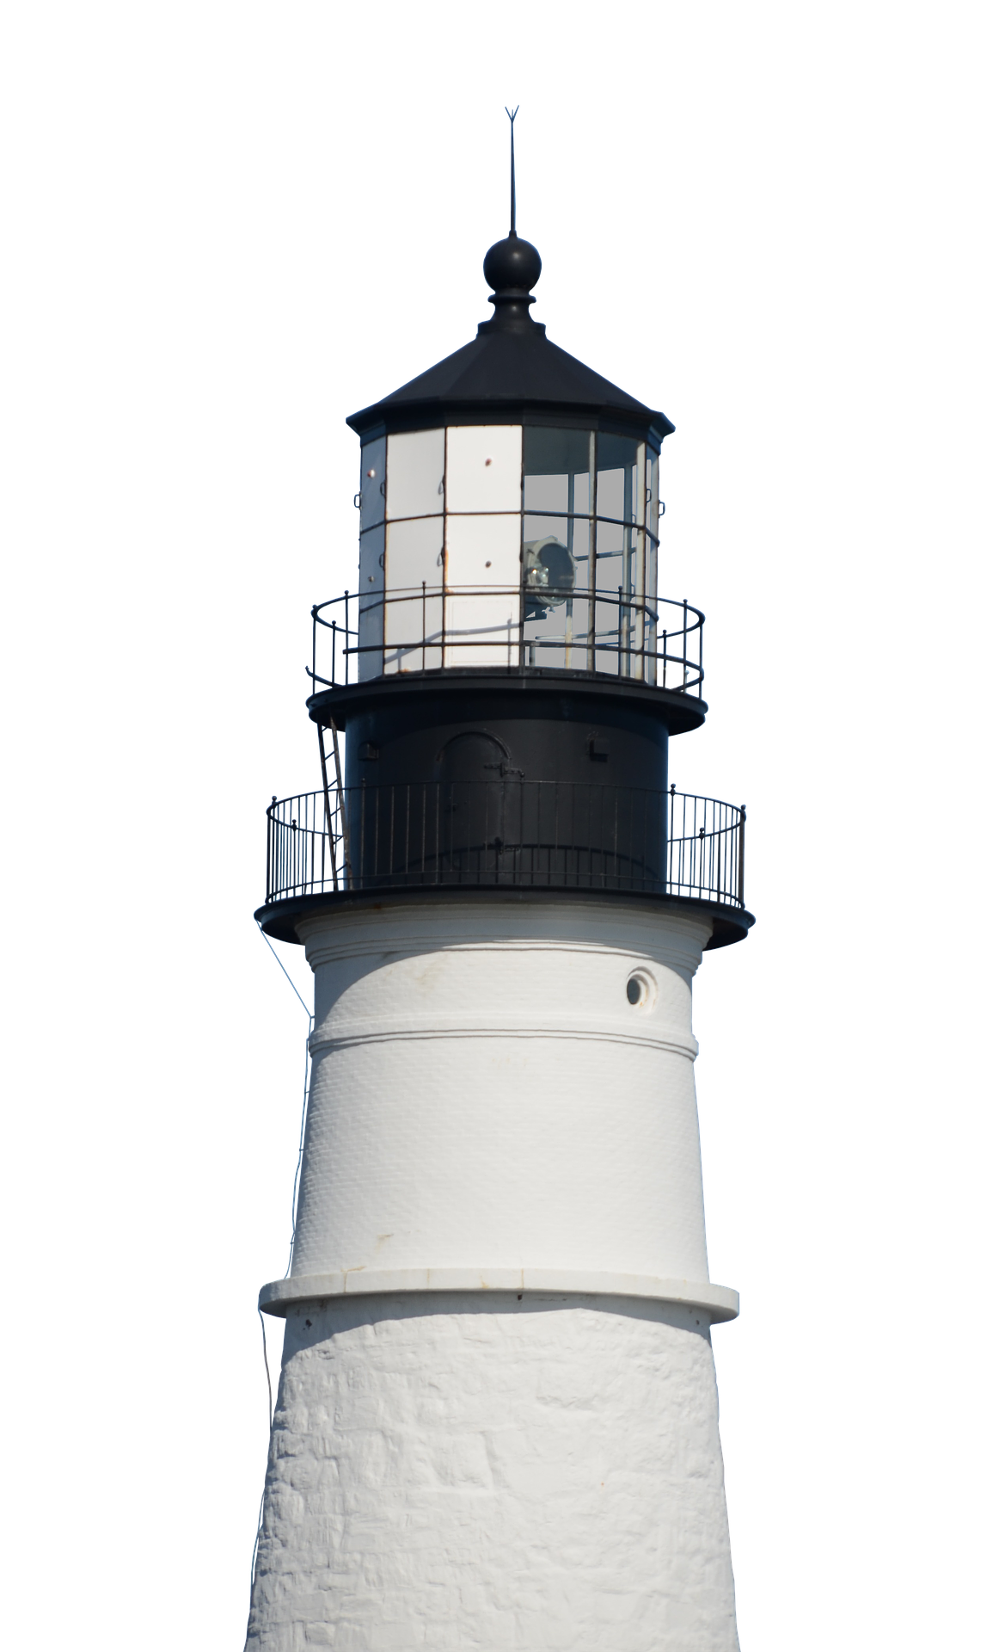
Example: Library skills sessions
First Year
Introduction to Harvard referencing
Finding and working with articles in scientific journals
Using Digimap software
Second Year
Developing independent study skills pre-field trip
Planning your dissertation research
Third Year
Bespoke dissertation sessions
Notes:
See how the skills are scaffolded as students progress through the course.

Slide 6
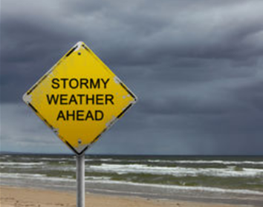
Example: Careers skills sessions
First Year S1: how to make most of degree, explore destinations & options, how we can help, Audit
S2: Activities & resources to develop self-awareness
Second Year S1: Insurance risk management talk from CII; and how to research opportunities
S2: Audit revisited; session on CVs and applications
Third Year S1: grad recruitment cycles, drop-in and central workshops re jobs/study recruitment processes
S2: Quick reminder of our support

Slide 7
The audit and its questions
A Google form was sent to students in semester 1 of year 1 and semester 2 of year 2
Questions focused on key library and employability capabilities and asked students to rate their confidence
1. Confident, lots of experience.
2. Some experience, but I'd like to be better.
3. Very little experience.
4. I don't have this skill yet.
Notes:
Audit was introduced in class. Link to form then shared on Moodle and by email. Follow-up email by Student Support Coordinator
Students rating their confidence to help them reflect - and inform us where they feel they are lacking in ability
We intend that the questionnaire is re-visited in 2nd year so that it informs the student journey in developing these skills
Significance of the word ‘yet’ in ‘I don’t have this skill yet’
Self assessment carries pros/cons and has limitations - in a short session today we are focusing on what we have done.

Slide 8
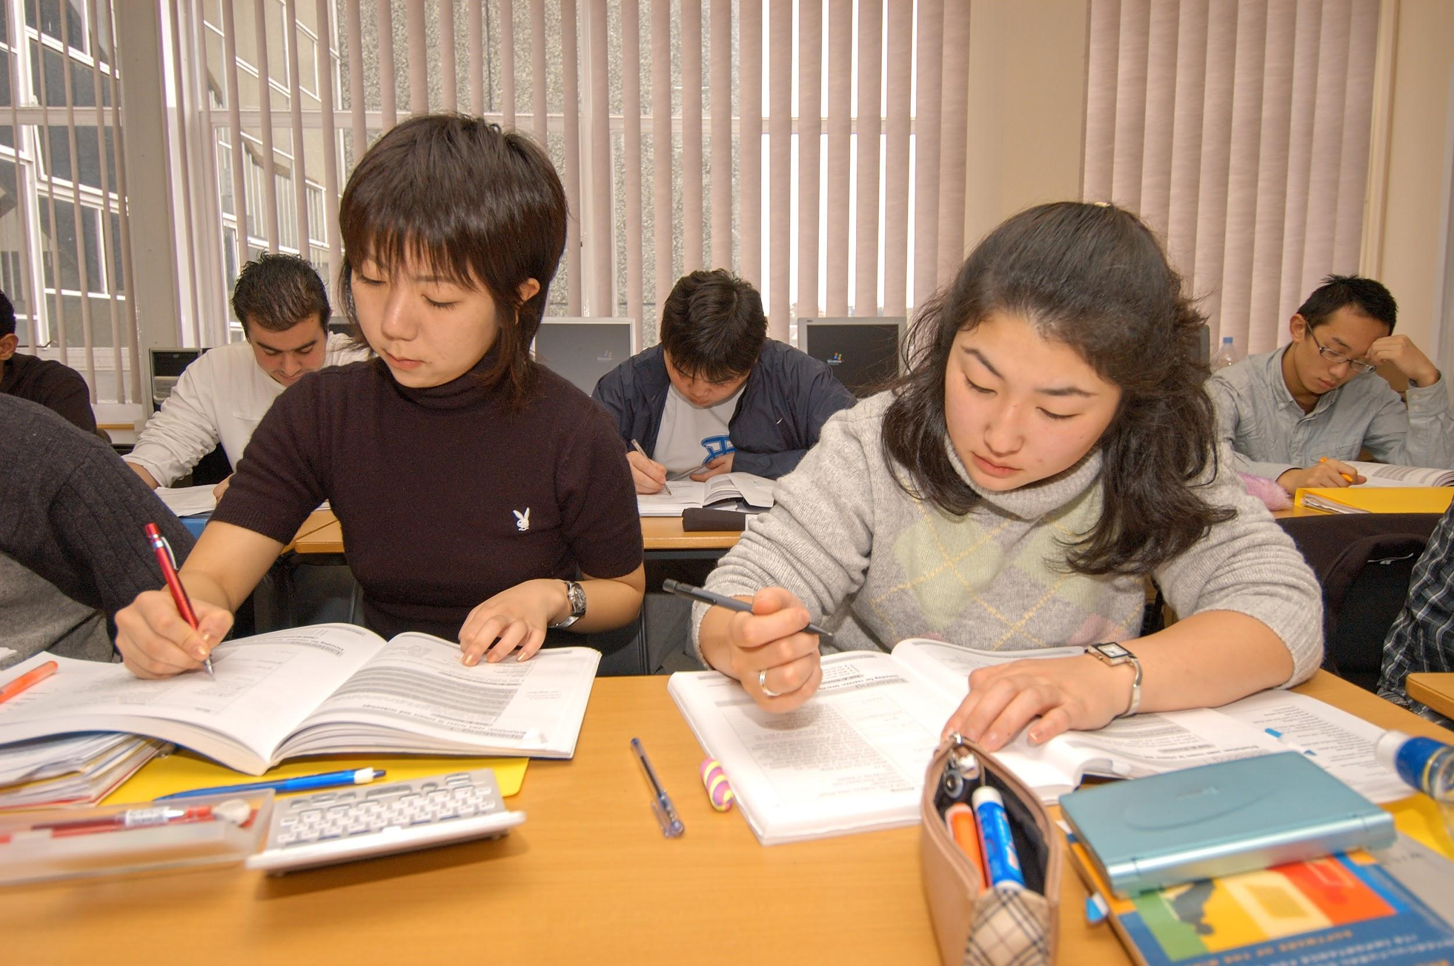
Examples of questions asked
“I understand what 'peer- reviewed' means and how to identify a peer-reviewed journal”
“I know how to identify useful keywords or search words for a topic and how to use them to search effectively.”
“I can work independently,
without substantial supervision”
Notes:
Charlie and Liz identified essential library / research skills and skills relevant to future employability from a range of sources
Given challenge to self-evaluate skills and confidence across 50 areas
Questions will be shared via handout - referring to how we designed this

Slide 9
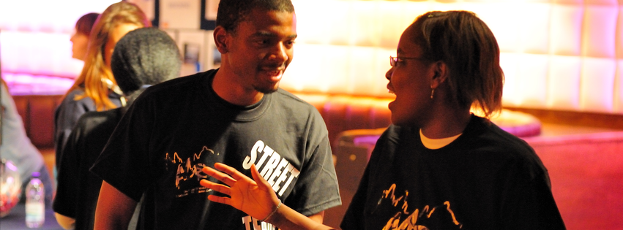
Examples of questions asked
“I know how to co-operate, negotiate with and persuade others when working in groups”
“I am able to able to analyse facts and situations and apply creative thinking to develop appropriate solutions”
Notes:
Charlie and Liz identified essential library / research skills and skills relevant to future employability from a range of sources
Given challenge to self-evaluate skills and confidence across 50 areas
Questions will be shared via handout - referring to how we designed this

Slide 10
The respondents
Survey 1 - Semester 1 of 1st year:
Survey was open to 141 students (97 were Geographers)
59 responded (42% response) (Geographers: 61% response rate).
Survey 2 - Semester 2 in 2nd year:
Survey open to 95 students (all were Geographers)
41 responses were received (43% response rate).
24 geography students participated in both initial and follow-up audits (25% response rate).
Notes:
Some students in the initial survey were taking Introduction to Human Geography as a module but their degree was in another subject e.g. Anthropology, Politics, International Relations, Sociology
The overall trend in responses show an increase in confidence across the entire skillset investigated, with a 23% increase (from 27% to 50%) in students who felt they were "confident with lots of experience"

Slide 11
Results
The two questions that saw the biggest change:
I can choose between a range of search tools and databases, and pick the most appropriate tool for each task or assignment
56% 95%
I can synthesise and appraise new and complex information from different sources
51% 88%
Notes:
Blue segment is “confident, lots of experience” and it has grown significantly

Slide 12
Findings and reviewing our practice
Self assessment has pros/cons but assists learning
Students reflected on strengths and development needs and could review needs with staff
Raised awareness of resources and support
First cohort of data suggests that embedding careers and library skills in compulsory modules strengthens students’ skills development
It also informs future skills sessions (and wider teaching?)
Need to explore how to increase response rates
Would students develop the skills independently? (unethical to have a control group)
Notes:
Self assessment did provoke students to reflect on their strengths and weaknesses and provide a sense of direction for them to access further information
Self assessment is an indicator but does not tell us everything - it needs to be weighed, can't always be relied upon, are personal and subjective (others may disagree, we may rate ourselves to highly/harshly, our perspective may change etc.
Discussion
- First cohort of data suggest that embedding employability and library skill sessions into compulsory modules results in a strong development of those skill over the first two years of university study among geography students.
- It is clear that some skills are more readily developed than others, thus this can be used to guide future skills session content, and perhaps broader teaching perspectives across the subject. For example, use of referencing software exhibits an increase in perceived skill level, but is still very low in confidence overall across the cohort.
- A limitation of this work is the response rate of geography students - just 25% participated in both audits. A greater response rate would help shape future sessions better, although it could be argues that those who participated are the students who are the most engaged, thus we are tailoring to their preferences, and are the most likely to respond positively to this targeted approach.
- It is not possible from these data to determine whether students would have developed these skills independently of the embedded skills sessions, however, it is not ethical to disadvantage a control group by withholding such skills sessions from their degree study.

Slide 13
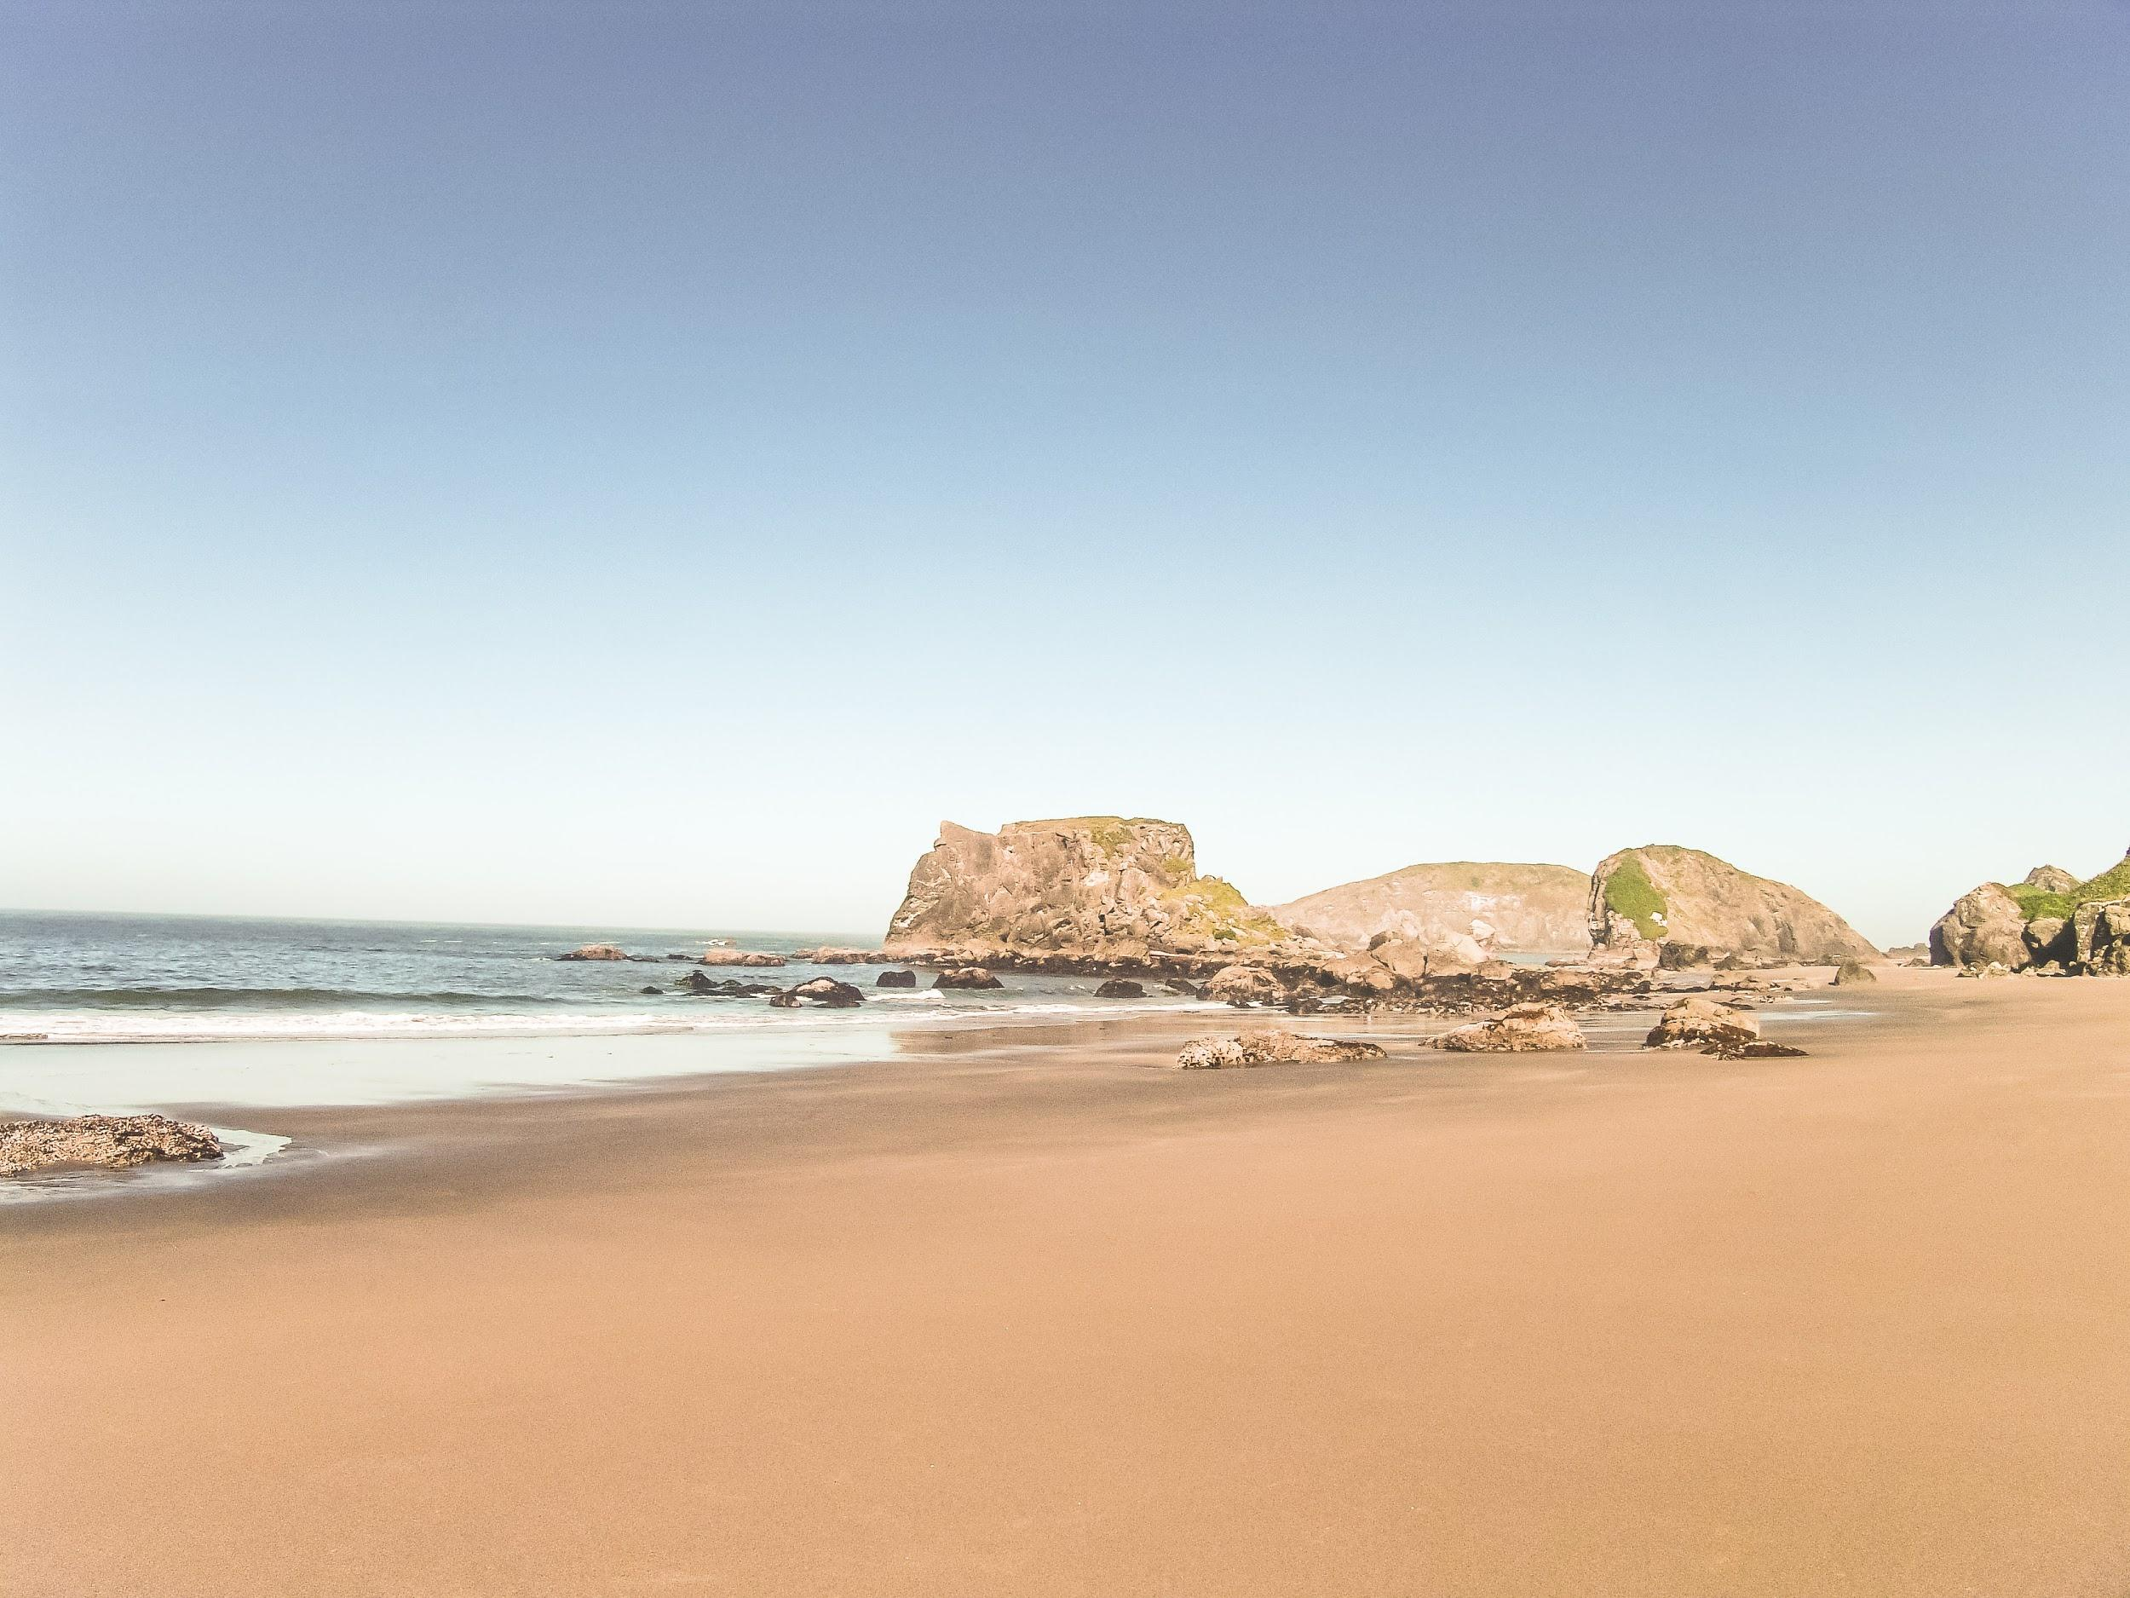
Your thoughts and questions?
Charlie Brampton, Wes Fraser, Pete Smillie and Helen Walkington

