Slide 1
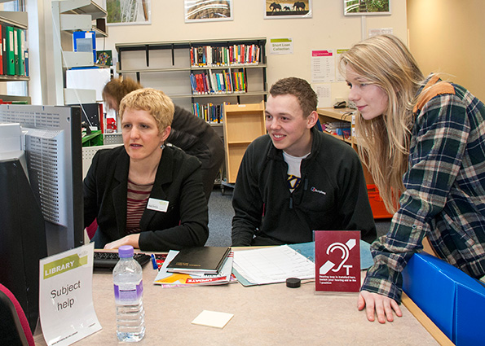
“Can’t you just give us 2 sides of A4?” . Stepping up Library use from school to higher education
Hazel Rothera
Oxford Brookes University
hrothera@brookes.ac.uk
@hrothera
Notes:
Title – from a conversation with 2nd year undergraduates last year. Session on literature searching, co-teaching with module leader, on module where the assignment involved them writing a literature review. “How do we write a literature review?” Pointed out module reading list with multiple books on the topic. “We don’t want a book, can’t you just give us two sides of A4?”
Perception – accurate or not – in UK higher education & globally that university students are less & less willing to invest time in long-form reading & that even as search tools are evolving to make it easier to find appropriate academic resources, students are less & less willing to engage with those.
Some questions for you to ponder as I share some thoughts on the issue: does this resonate with your experience of the students you work with? Does it matter? And if it does, what can you as school librarians, teachers or school leaders do about it?

Slide 2
Perspectives on the issue
My experience
Evidence from students
What?
Evidence from colleagues
Evidence from the literature
Now what?
So what?
(Brookfield’s four lenses)
(Rolfe et al’s reflective model)
Notes:
I’m going to try and look at it from several perspectives, using a model that’s widely used in HE, Brookfield’s “four lenses”: what it looks like to me, to students, to my academic colleagues, and what it looks like more broadly in the research literature.
And I’ll structure my presentation using three questions, a reflective model first used in healthcare by Rolfe: What… are we seeing? So what… does that mean? Now what… are we going to do about it?

Slide 3
What are we seeing?...
In the last ten years search tools have gone from this…
Notes:
From the perspective of HE libraries and librarians, using search tools such as catalogues and databases to find appropriate sources has got vastly easier for users in the last few years.
Ten years ago, most of my information literacy teaching time, and time supporting individual students and writing support materials and tutorials, was often spent on getting them over technical hurdles of how to log in…

Slide 4
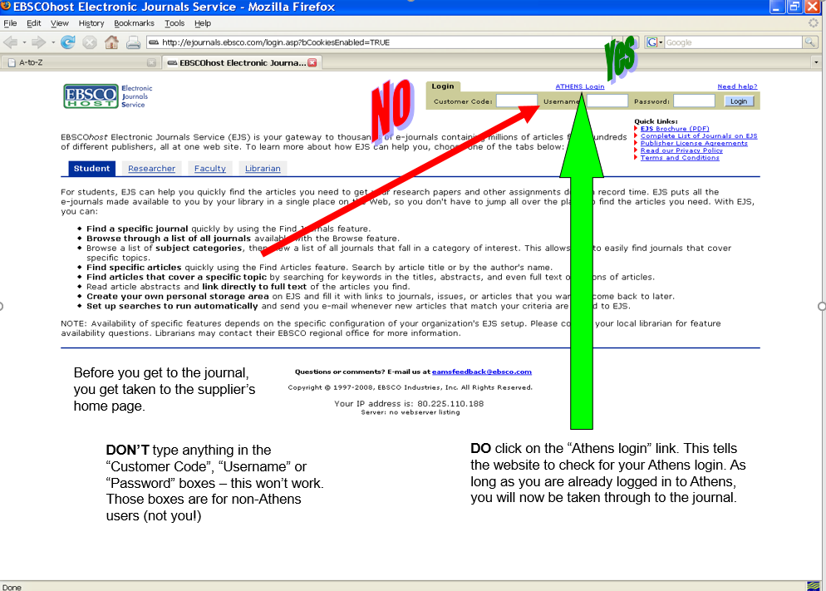
Notes:
… let alone structure a database search, with Boolean logic and searching in the right fields, when they did get in.
(Real slide from a tutorial I produced in 2007, showing off-campus students the right way to log in via Athens.)
Just helping students navigate to the full text of an online journal article took so much work that as librarians we often didn’t have much time left over to work with students on what they did with those resources having finally located and navigated to them.

Slide 5
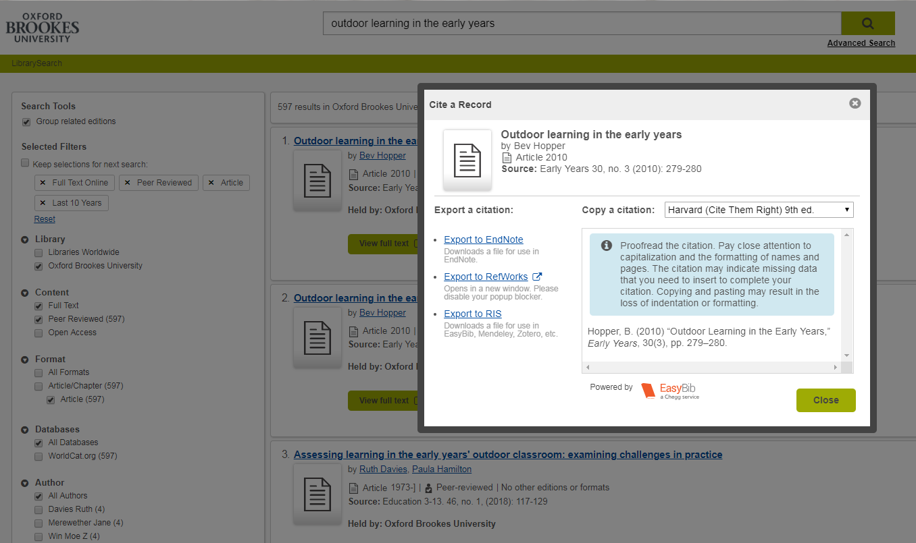
… to this
Notes:
Contrast – screenshot from our current discovery system, LibrarySearch based on an OCLC platform, at Brookes.
Single search box for Google-style phrase search. Boxes to tick down the left hand side – limit to journal articles, peer reviewed, published in the last 10 years, available full-text online, in just a few clicks.
System can even cite their chosen sources in Harvard referencing style for them.
So is everything now rosy? Well, not quite – students still need our support, but…

Slide 6
Shift in support: from finding to understanding and using
That student didn’t know what the key terms meant
Was I supposed to read the stuff on the reading list?
Time, comprehension, strategic/surface approach, metacognitive issues…
They can find journal articles now but still don’t use them because they say they don’t understand them
Notes:
My perspective – typical example; student comes to the Library Helpdesk saying she “can’t find any articles on her topic” which was to do with motivation in trainee sports coaches. We run through a search. I point out an article on the first page of results, about self-actualisation in coaching, which seems to be exactly what she’s looking for. “What about that one?” “Oh, I didn’t know what that meant, is that to do with motivation?” – hadn’t occurred to her to look it up.
Student perspective; not clear to our students what, when, how or how much they are expected to read. 2nd year student who had failed a module – tutor came to see me tearing hair out – “Where were the key theorists, they were all on the reading list” – “Was I supposed to read the stuff on the reading list?”
Academic colleagues – tell me they know students can find appropriate sources now, because they’ve all had training sessions with the Library on how to use our search tools, but bibliographies at the end of assignments still full of blogs, newspaper articles and other non-academic sources.
Journal literature tells us these concerns about student reading are widespread and worldwide. Students are time-poor, take a strategic and surface approach to learning, and while this often drives them towards online access to texts, there are metacognitive issues around reading online which research suggests mean they take in less information and understand it less deeply than when they read on paper.

Slide 7
So what… (does that mean?)
Students find the idea of long-form reading very offputting
They find it difficult to engage with lengthy, dense texts, especially online
Tension between wanting convenience of e-texts and finding paper easier to read and comprehend
Need support with the idea that it is possible to learn to be an academic reader (and then thinker and writer)
… but they need to put the work in to achieve that
Notes:
Duncan et al 2016 in the British Journal of Psychology; looked at several hundred young people aged 11-15; “Although more time was spent on digital than on traditional texts, traditional extended text reading was the only reading habit to predict inference-making in comprehension and to distinguish skilled from less skilled comprehenders.” – students’ reading habits have already been formed well before they get to university.
A study by Singer & Alexander in 2017 found that while students said they preferred digital texts, and thought they would understand digital texts better than print ones, they *actually* when tested remembered better information they’d read in print. By contrast, major international study by Mizrachi et al (in which Jane Secker was involved), reported this year in PLoS One , found that across thousands of university students in numerous countries, most prefer print for academic reading and report better focus & retention reading in print. But because students are very time-pressured and print texts often take longer to get hold of, waiting in a Library reservation queue or having to travel to campus rather than grabbing the reading on their phones or tablets, it’s easy to default back to online.
That mirrors my own small-scale findings in a research project I did with my Education students for a university learning & teaching fellowship in 2012-14. Nearly all the students said they *preferred* to read print books, or printed-out journal articles. But they also wanted all their key texts available as e-books, so that they could always access them and didn’t have to travel to campus from home or placement. They admitted to liking the convenience of quickly looking up a quote which backed up the point they wanted to make – which as researchers and writers we’ve all done – but there is then the risk that they never engage with the whole text and its arguments, just grab snippets.
I think – and writing from elsewhere in HE suggests academics find the same – that… [need support and can learn]

Slide 8
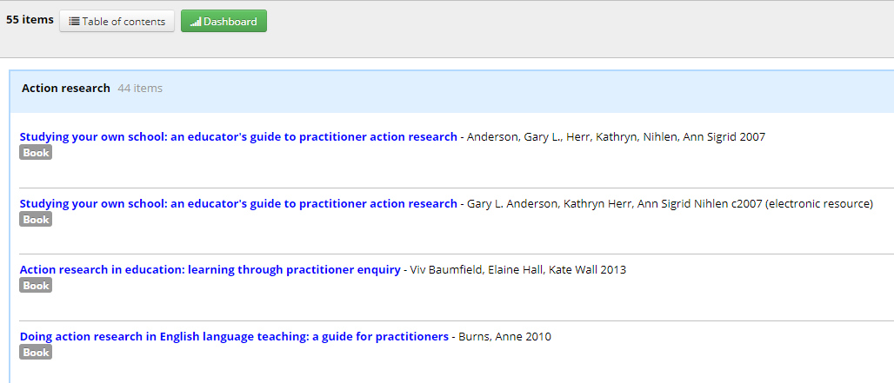
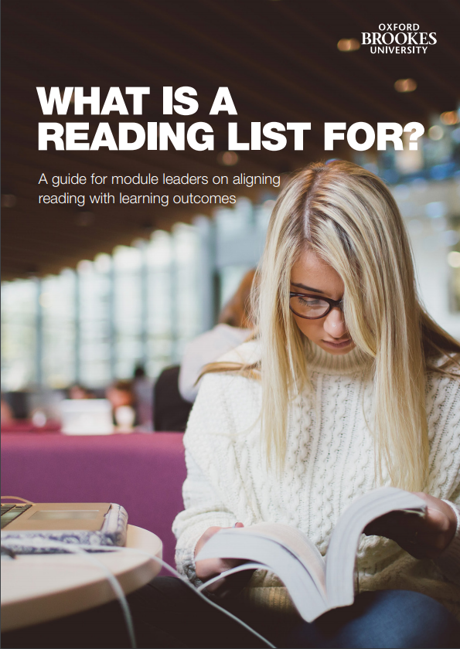
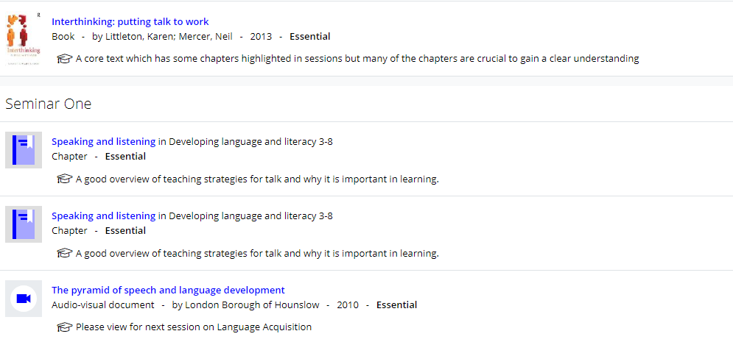
Now what… do we do?
(Croft, 2018)
Notes:
Here are some things we’ve been doing at Oxford Brookes.
Mentioned reading lists earlier & how to get students to engage with them. Dan Croft – two-year Learning & Teaching Fellowship – looking at constructively aligning reading lists with rest of teaching. (Constructive alignment – v popular theory of teaching & learning in HE – holds that everything you get students to do, from classroom activities to reading to how you assess them, should be *aligned* with your *learning objectives* for the course or module, ie what do you want students to learn & how are you going to get them to learn it. Has its critics – what if students learn other things etc? – but very widely used, and no-one had looked at constructively aligning reading lists before.
Output from Dan’s research was this guide – What is a Reading List For? Encourages academic colleagues to rethink reading lists (at Brookes we use Aspire software) so that instead of being one long alphabetically-ordered list, lost/overwhelmed, no signposts, list is *aligned* to the teaching. By weeks or by themes, indicating what’s essential, recommended and optional, with annotations guiding students in *why* they might read a particular text & *what* they could expect to get out of it. Help them prioritise & guide their reading.

Slide 9
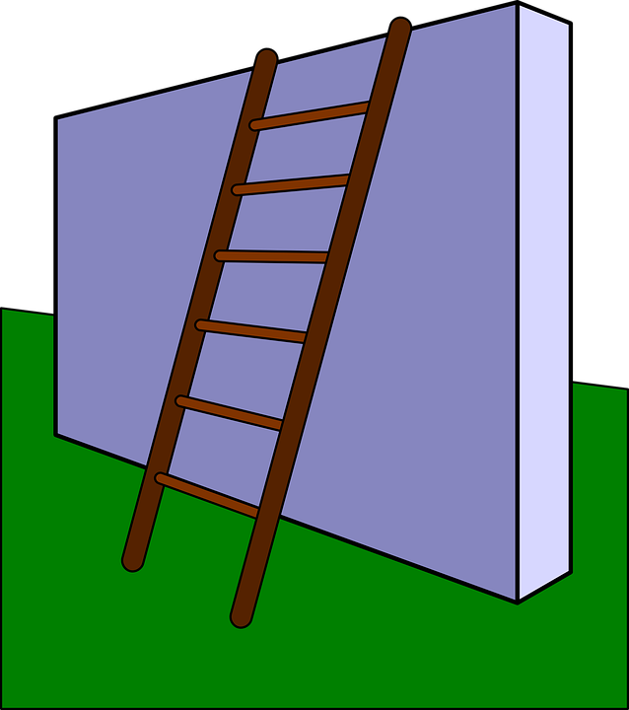
The information ladder…
…until you can understand the in-depth research findings.
Research is mostly reported in journal articles
… read article abstracts
Abstracts are summaries of the key points of a journal article
…get the background from a textbook…
Textbooks from the Library
… use a dictionary to learn any words you’re not familiar with…
Look in our Quick Ref section or online
Read a basic but reliable introduction to the topic…
(good quality Wikipedia article, encyclopedia entry, reliable Web site)
You’ll need to work your way up the information ladder!
Notes:
Here’s something I’ve been doing – help students with notion of gradually learning to read dense, difficult academic texts. Slide from seminars I gave this semester to Year 1 Primary Teacher Education students. Their feedback after seminar said this was one of most useful ideas they picked up. Like starting weights at the gym or learning to play a musical instrument – it’s hard, it gets easier. Second year feedback in course committee last week about same module’s assignment bore this out; “Everybody finds that one really hard as it’s the first one, but it makes all your subsequent assignments easier.”

Slide 10
… and the reading iceberg
Kils & Bodo, commons.wikimedia.org
Notes:
This led on to the second idea of the “reading iceberg” – students reluctant to read what they can’t cite in assignments – but they may need to do it in order to reach the peer-reviewed journal articles which are visible above the surface in their assignments.

Slide 11
Elsewhere in the sector…
Workshops aimed at supporting students to become ambassadors for more effective information literacy practices (eg SADL project, LSE 2013-2016)
Academics rethinking what, how and why they expect students to read and how they communicate this – building reading resilience (eg Australian Learning & Teaching Council 2010-2012)
Explicitly teaching pre-reading strategies – course structure, key points of readings, connections between readings, teach the structure of a journal article
Communities of practice where academic staff and librarians work together on issues of critical information literacy (eg York St John)
Notes:
SADL – Jane Secker at LSE – librarians working in collaboration with students
Jude Seaboyer’s work with ALTC – building the idea of *reading resilience*, intellectual muscle, with weekly online quizzes and discussion activities, for which students get marks, which they can only participate in fully if they’ve done the week’s assigned reading.
Pre-reading work – helping students to see where the reading fits in to course context and their learning – Heather Bandeen from Ohio State University 2009 eg.
Collaborative work between librarians and academic staff, as always, is also key (Clare McCluskey Dean)

Slide 12
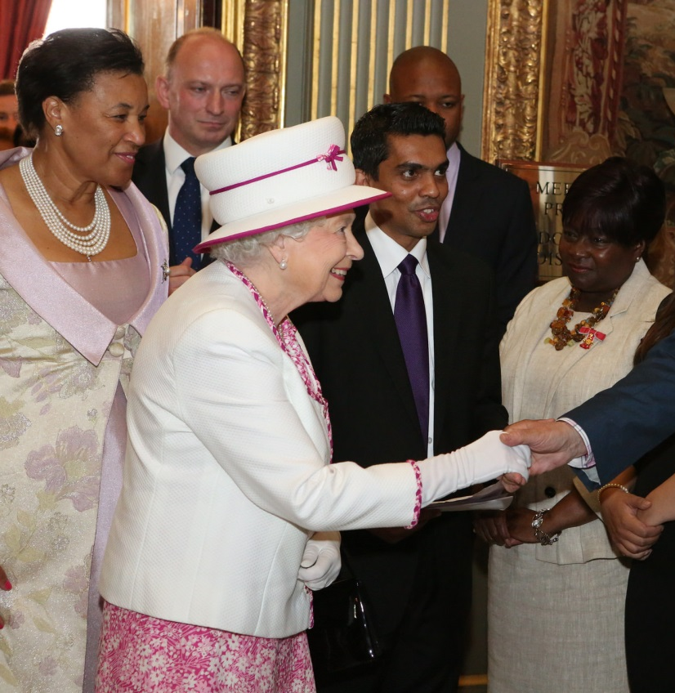
And what do you do?...
Do you recognise the situation I’ve described?
What’s causing it?
Does it matter?
If so, what does that mean for school librarians, teachers and school leaders?
Notes:
I’ll leave you with the questions I posed at the beginning, for discussion and thoughts either now, across the rest of the day, or to take home with you…

Slide 13
References
Brookfield, S (1995) Becoming a critically reflective teacher. San Francisco: Jossey-Bass.
(Brief open-access explanation of Brookfield’s four lenses here.)
Croft, D (2018. What is a reading list for? Oxford: Oxford Brookes University.
(Available open access here.)
Croft, D (2018) Embedding constructive alignment of reading lists in course design. Journal of Librarianship and Information Science. (Open-access preprint available here.)
Duncan, L (2016). Adolescent reading skill and engagement with digital and traditional literacies as predictors of reading comprehension. British Journal of Psychology 107(2), 209-238, (Open-access preprint available here.)
Information Learning & Estates, York St John University (n.d.) Information in the curriculum. (Available here.)
Jenks, A (2016). Why don’t students read? Teaching Tools, Cultural Anthropology website. (Available here.)
Kennedy et al (2014). The reading resilience toolkit. Canberra: Australian National University. (Available here.)
Notes:
References – these slides will be made available afterwards – all available legitimately open-access so you can follow up if interested.

Slide 14
References (continued)
Mizrachi et al (2018). Academic reading format preferences and behaviors among university students worldwide: A comparative survey analysis. PLoS One. (Available open access here.)
Rolfe, G et al (2001) Critical reflection for nursing and the helping professions: a user’s guide. Basingstoke: Palgrave. (Brief open-access explanation of Rolfe’s reflective model here.)
Rothera, H (2015) Picking up the cool tools: working with strategic students to get bite-sized information literacy tutorials created, promoted, embedded, remembered and used. Journal of Information Literacy 9(2), 37-61. (Available open access here.)
Secker, J (2017) ‘Students in the SADL: lessons from LSE’s digital literacy programme’. In: Reedy & Parker (eds), Digital Literacy Unpacked. London: Facet, pp 83-96.
(Chapter available open access here.)
Singer, L, and Alexander, P (2017). Reading across mediums: effects of reading digital and print texts on comprehension and calibration. Journal of Experimental Education 85(1), 155-172. (Available open access here.)
Weimer, M (2010). 11 strategies for getting students to read what’s assigned (Faculty Focus Special Report). Madison, Wis.: Magna. Available open access here.

Slide 15
“Can’t you just give us 2 sides of A4?” . Stepping up Library use from school to higher education
… questions?
Hazel Rothera
Oxford Brookes University
hrothera@brookes.ac.uk
@hrothera

