Slide 1
How can Group Work Enhance Learning?
Stewart Chidlow, Adrienne Duggan,
Aspa Paltoglou & Robyn Stiger
Notes:
Strictly alphabetical order :)

Slide 3
Activity 1 :
Why is it important to make students work in groups?
Notes:
Discuss how group work can enhance learning.
Groups:
Individuals (two)
Group of eight
4 group
Two group
Disadvantages of a really big group
Disadvantages of working on their own.
Cosiness of group of two
Group of four ideal?
From what I remember, in our activities we will just focus on the group size, and not on the type of intervention by the facilitator.

Slide 4
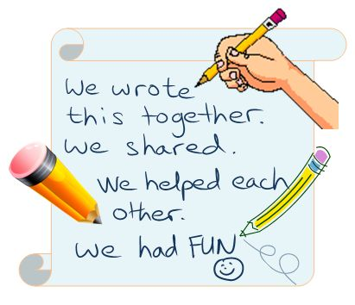
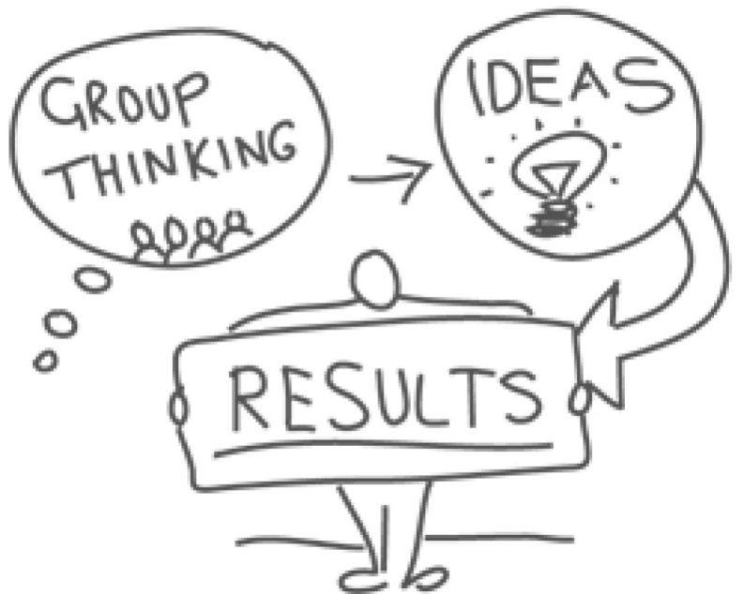

Slide 5
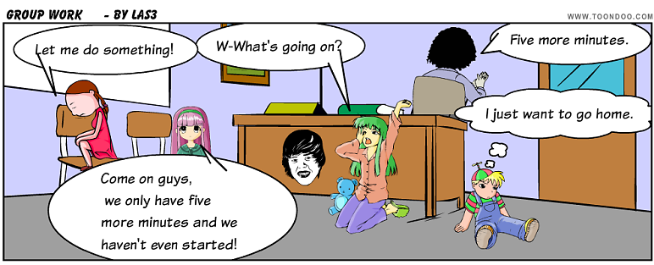
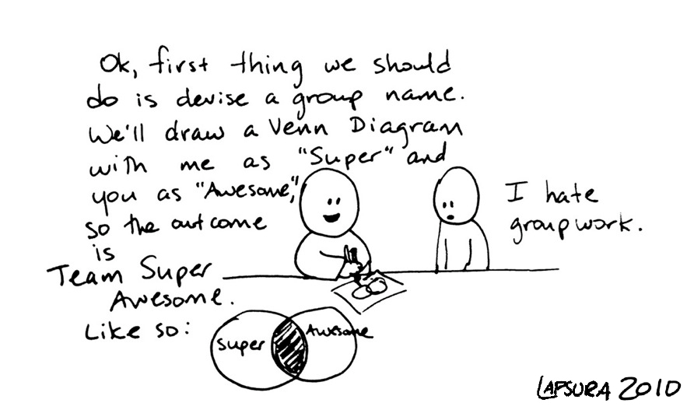

Slide 6
What is group learning?
‘The activities through which individuals acquire, share, and combine knowledge through experience with one another’
(Argote, Gruenfeld & Naquin, 2001: 370; in Wilson et al., 2007).

Slide 7
Group work is important & beneficial
Students develop important social cognitive & reasoning skills
(Kyprianidou et al., 2011).
Employers are asking for skills related to team-working
(Morey et al., 2002, cited in Gordon)
Group work leads to better learning, better retaining of information than individual teaching, better student satisfaction
(Kyprianidou et al., 2011).
Paradigm shift towards social constructivism: Students become active learners & create knowledge, instead of being passive recipients of knowledge
(Johnson, Johnson & Holubec, 1992, cited in Mitchell et al., 2004)
Concept of “The Social Brain” – synergistic relationship, rather than the sum of many parts.
(Littleton & Mercer, 2013)
Creative & collective is powerful
(Littleton & Mercer, 2013 , Sawyer & de Zutter, 2009)
Notes:
Literature review
‘The Social Brain’ Karen Littleton and Neil Mercer in Interthinking, 2013 Routledge:London As humans we are able to think collectively- more than the rest of the animal kingdom. Discuss, offer advice, share experiences etc. Social brain is well designed to read others’ intentions. Inventiveness and creativity is usually the work of a group of people as opposed to just one: the Bloomsbury Set, The Glasgow Boys, The Beatles and these people influenced each other so that the relationship was synergistic rather than just a sum of the parts. We have a romantic image of the genius whereas a collective is more ususal.
Lev Vygotsky; talked about the cycle of learning, where new ideas feed into existing ones and socio culture theory is based on this. Human intelligence is powerful and creative because it is collective.
Creativity emerges from these discussions (Sawyer and de Zutter 2009)

Slide 8
4 important elements in group-based learning
Groups should be formed & managed in an effective way
Students should be responsible for the quality of group & individual work
Feedback should be given to students frequently
The activities shouldn’t only promote knowledge, but should also promote the group development
Michaelsen & Sweet (2008)
Notes:
Michaelsen and Sweet (2008) identified 4 important elements for team-based learning:

Slide 9
What is the optimal group size?
Laughlin et al., (2006) showed that groups of 3, 4 and 5 people performed better than groups of 2 in a problem solving task.
There was no significant difference between the groups of 2, and the participants working on their own. So groups of 2 do not appear to be ideal.
There was no significant difference between the groups of 3, 4 and 5 people.
Further research is needed to see whether that is the case for all tasks at hand & the field of study.
Interesting article by Kelsey (2009) on optimal group numbers – especially in Snipers!
Notes:
http://psychology.about.com/od/psychologynews/qt/groupsize.htm
> - How does that relate to your experience of teaching groups of students? > > > > - Does the optimal group size depend on the task at hand?
Info from Kelsey 2009 article
The smallest viable group size seems to be somewhere in the range of 5 to 9.
Looking smaller, we see that a group of 2 can be tremendously creative (ask any parent), but often has insufficient resources and thus requires deep commitment by both parties.
Consider for example the difficulty of a 2-person business partnership which can be compared to that of a marriage.
A group of 3 is often unstable, with one person feeling left out, or else one person controlling the others by being the “split” vote. It is for this reason the Military sends Snipers out in groups of 3. The shooter and the calibrator are teamed as a pair and the third watches out so they don’t get spotted.
A group of 4 often devolves into two pairs.
What is the ideal number?
Perhaps it is at 5 that the feeling of “team” really begins. At 5 to 8 people, you can have a meeting where everyone can speak out about what the entire group is doing, and everyone feels highly empowered.
According to Christopher Allen there is a study from the 1950s that shows that the optimum size for a committee is 7.

Slide 10
Activity 2:
What are the problems that can arise when working in a group?
Notes:
Then, groups of four. What are the problems that can come up when working in a group?
There and then discuss about a problem. We decide on one of the issues that came up.
Possible problems that might come up:
Influence of personality of the students on group work (e.g. dominating vs passive students).
Disagreements within the group.
Groups were there are no active students, and the group has no direction.

Slide 11
Group work is important & beneficial, but how can we make sure it runs smoothly?
We identified 3 important issues relating to group work, each associated with challenges & possible ways to overcome these challenges.
Group size
The effect of students’ dispositions & different student types: passive vs dominant students.
Intervention from facilitator: Should the facilitator facilitate passively or actively?

Slide 12
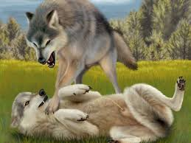
2. Passive vs dominant students.
Balasooriya et al (2009) interviewed lecturers that were ‘facilitators’ of group work.
They identified 2 broad categories of students : Passive & dominant.

Slide 13
2 types of Dominant students
Dominant disruptive students:
‘lack of discipline’
‘attention-seeking behaviour’
Highly enthusiastic dominant students:
‘interested in learning’
‘keen to make positive contribution to the team’
Notes:
Here is some more detail from the paper:
The dominant students
Facilitators identified management of “dominant students‟ as a challenge they commonly face. While dominance was generally regarded as a type of behaviour to be discouraged, the range of behaviours that were described suggested that there were two separate types of dominant behaviour. While one type of dominant behaviour was found to be disruptive, the other type appeared to have potential to play a positive role in fostering a collaborative learning environment. These two types of behaviour are summarised below.
1a. The dominant disruptive students: Facilitators tended to describe these students using terms such as “immature” “attention seeking” or “lacking in discipline”. These students tended to hinder the progress of the group by their desire to speak excessively on irrelevant or marginally relevant issues, and tended to distract the group or take up a disproportionate amount of group time. Facilitators also described a more extreme version of disruptive students, and used terms such as “difficult students” and “bad apples” to describe them. They described these students‟ behaviours as “arrogant” and “disrupting the cohesion of the group”. Facilitators generally reported this type of behaviour as extremely problematic, and requested more support to develop skills to deal with such situations.
1b. The highly enthusiastic dominant students: Facilitators tended to describe these students with the term “outspoken”, but generally spoke of them as having potential to influence the group positively. Although these students are similar to the above students in their tendency to take up a disproportionately large share of the time available for discussion, they differ from the above by their genuine desire to engage with the learning process, and by making productive contributions to group discussions.

Slide 14
2 types of Passive students
‘Disinterested’ students:
tend to avoid participation
‘Quiet students that work by themselves’: usually interested but lacking in confidence
Notes:
Facilitators described a range of students who came under the broad umbrella of „passive students‟. The descriptions suggested two very different types of apparently passive behaviour.
2a. The disinterested students: Facilitators used terms such as “lurkers”, “students with negative attitudes” and “lethargic” to describe these students. These students seemed to attend merely to meet attendance requirements, and generally tended to convey the impression that they would rather be elsewhere. They were not only passive, but generally found ways to avoid participation even when specifically allocated a task.
2b. The quiet students who work by themselves: Facilitators generally described these students as “quiet”, “shy”, and “lacking in confidence”. Facilitators indicated that they would like to develop skills in drawing out these students into discussions. There was a general impression that these students could make a useful contribution to the discussions if they could overcome their unwillingness or uncertainty in engaging with their peers. While there was concern that these students were not benefiting fully from the collaborative learning sessions, their behaviour was generally not felt to impact significantly on the group process.

Slide 15
Strategies to ensure harmonious group work
Allocate leader roles to students.
Pairing up students with complementary personalities & skills.
Ask students to reflect on the group work at the end of the session.
Talk to each student individually.
Notes:
I think the role of the facilitator features in here……helping the group if they are on the wrong track, not interfering if they are okay.
I think the top 2 bullet points should be taken out.
But I am not sure what you would like me to put in here!

Slide 16
Strategies to ensure harmonious group work
Put dominating students in charge – then they realize the difficulties of facilitating the group work. Good idea to monitor the situation though.
Put quiet students in charge, but giving them sometime to prepare beforehand. Again, it is important to monitor and support the group
(Balasooriya et al, 2009)

Slide 17
3. The role of the facilitator
Should the facilitator choose groups or should groups choose themselves?
Should the facilitator assign roles to students?

Slide 18
Should the facilitator choose groups or should groups choose themselves?
There is a evidence that students benefit most from group work when they work with other students that they get on well with
(Kagan and Kagan, 1995, cited in Mitchell et al., 2004).
Presumably when choosing their collaborators, they are more likely to choose people that they get on well with, so that might lead to more successful group work.
On the other hand, there is evidence that students themselves do not always consider it positive having to pick their own collaborators, as it can lead to groups that cannot work effectively (e.g. when weaker students are grouped together)
(Mitchell et al, 2004)
Notes:
In terms of choosing groups – perhaps list the different jobs and let the students decide on their own who does what.

Slide 19
Should the facilitator be assigning roles within the group , or should the students be left to work on their own?
Some authors note that students tend to prefer the roles that do not take them out of their comfort zone, which would encourage them to develop more skills
(Johnson, Johnson and Holubec, 2009).
They suggest that the facilitator could assign roles to students as well as ask them to rotate roles, so that all students can have experience in each role.
However, not all group work might lend itself to role rotation, and if a role assigned to a student is a source of distress, that might defeat the purpose of the exercise.

Slide 20
Conclusion
Group work is valuable for enhancing students' learning & preparing them for the work environment.
For it to be successful, various issues need to be considered: group size, facilitator's role, & the balancing the different dispositions of students.
Further research is needed to see whether these parameters differ according to the field of study & task the students are involved in.
Notes:
Littleton and Mercer 2013:
What makes productive discussions?
. Everyone offers relevant ideas and information
. Everyone’s ideas are treated as worthwhile
. People ask each other what they think
. They try to reach agreement
. People think they can think aloud
. People ask for reasons and give them

Slide 21
References
Balasooriya CD; Di CSK; Hawkins NJ, 2010, 'The facilitation of collaborative learning; what works?', Higher Education Management and Policy, vol. 22, no. 2, pp. 1 – 14
Gordon, J. The Group, the Team and the Task Force: The enhancement of group work as a teaching methodology. http://www.heacademy.ac.uk/resources/detail/subjects/
Johnson, Johnson, and Holubec (2009). Strategies for promoting and managing effective group work. Quality Learning and Teaching Induction & Early Professional Development.
Kelsey, A. 2009. Does the size of your group matter? Available at http://www.leadingleaders.net/articles/entry/does_the_size_of_your_group_matter/
Laughlin, P., Hatch, E., Silver, J., & Boh, L. (2006) Groups Perform Better Than the Best Individuals on Letters-to-Numbers Problems: Effects of Group Size, Journal of Personality and Social Psychology, Vol. 90, No. 4.
Littleton, K. & Mercer, N. (2013). Interthinking: Putting talk to work. Abingdon: Routledge.
Michaelsen, L.K., & Sweet, M. (2008) The Essential Elements of Team-Based Learning. New Directions for Teaching and Learning, no 116, DOI: 10/1002/tl.330.
Mitchell, S.N., Reilly, R., Bramwell, F.G., Solnosky, A., & Lilly, F. (2004) Friendship and Choosing Groupmates: Preferences for Teacher-Selected vs. Student-Selected Groupings in High School Science Classes. Journal of Instructional Psychology, Vol 31, no 1, pp. 20-32
Kyprianidou, M., Demetriadis, S., Tsiatso, T., & Pombortsis, A. (2012) Group formation based on learning styles: can it improve students’ teamwork? Education Tech Research Development, Vol 60, 83-110.
Wilson, J.M., Goodman, P.S., Cronin, M.A. (2007) Group Learning. Academy of Management Review, vol. 32, no. 4, pp. 1041-1059

