Slide 1
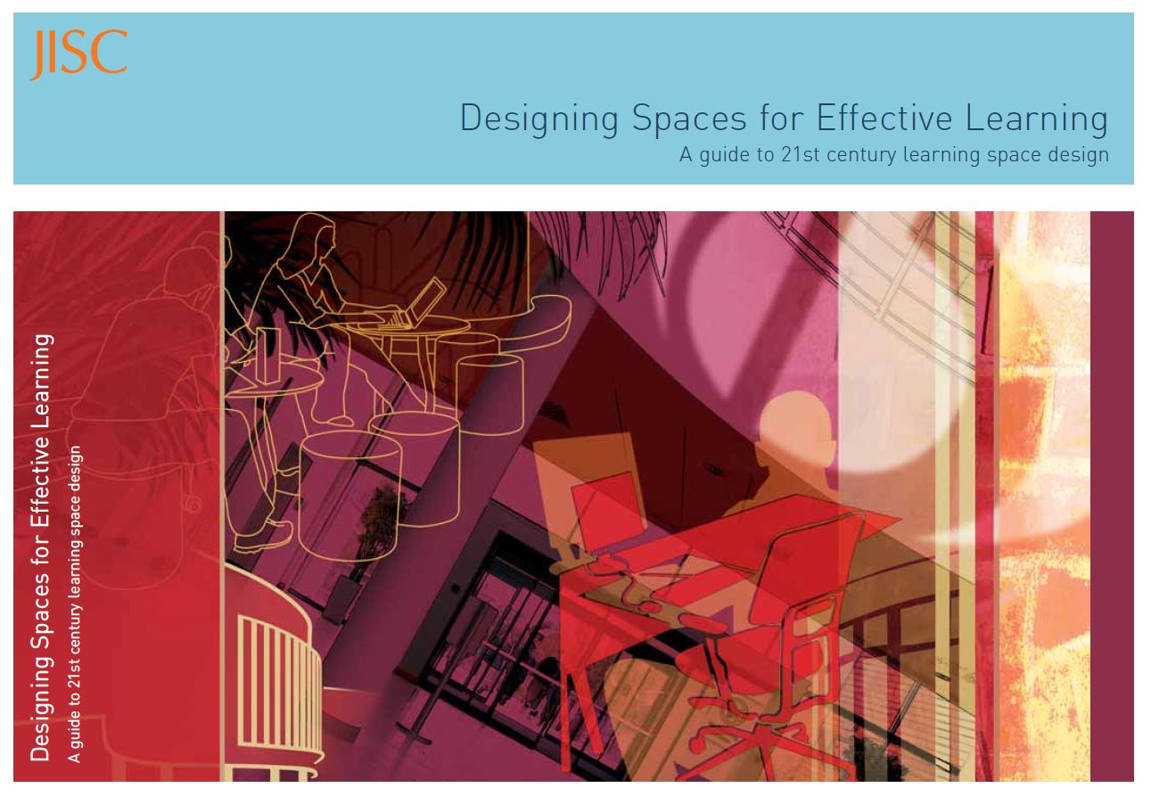
Space to think, or space to sink?: Does "one size fit all" in the design of learning spaces within contemporary higher education?
Emily Hill
Michael John-Hopkins
Siân Jones
Chris Lloyd
Joint Information Systems Committee: JISC.

Slide 2
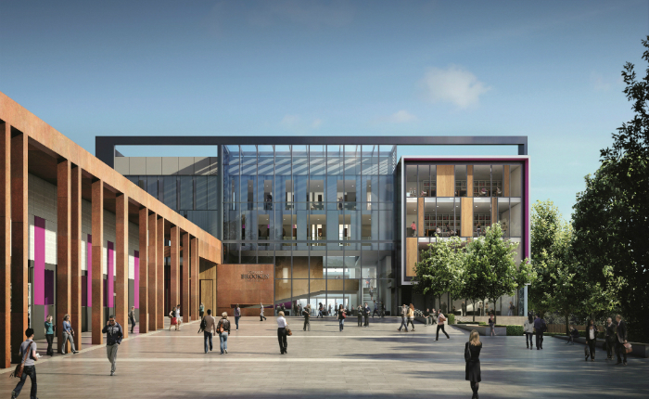
Space to think, or space to sink?: Does ‘one size fit all’ in the design of learning spaces within contemporary higher education?
March 19th 2014 (Greg set a)

Slide 3
INTENDED LEARNING OUTCOMES
By the end of the seminar, you will have:
Consolidated your understanding of seminar pre-reading through discussion and a practical ‘design a space’ activity
Gained an understanding of the policies and pedagogies that influence design and use of learning spaces in HE
Acquired an understanding of the extent to which learning space requirements vary across disciplines
Applied this knowledge to a real life case study: the new John Henry Brookes building

Slide 4
Space to think, or space to sink?
Key points to re-cap regarding the design of an educational building.
‘Designing Spaces for Effective Learning:
A guide to 21st century learning space design’ (2006)
http://www.jisc.ac.uk/uploaded_documents/JISClearningspaces.pdf
Flexibility to accommodate current end evolving pedagogies.
‘Future-proofed’ space which can be redesigned.
Bold qualities to look ‘beyond tried and tested pedagogies.’
Creative designs to ‘energise and inspire.’
Supportive surroundings to ‘develop the potential of all learners.’
Enterprising designs to make space ‘capable of supporting different purposes.’
These points are all fuelled by the aim that teaching and learning should
‘produce leaners who are confident, adaptable, independent and inspired to learn.’

Slide 5
Space to think, or space to sink?
Key points to re-cap regarding the design of an educational building.
The concepts of flexibility, future-proofing, boldness, creativity, support and enterprise should now be implemented across HE because students are now recognised as having the following characteristics:
IT capable and confident: social-networking, database engagement, constantly ‘online,’ email based, virtual learners.
Collaborative workers: the ‘lone-wolf’ approach is outdated and irrelevant for the modern social-based working world.
Timetable averse: they prefer to self-manage their studies and regulate their own work patterns.
‘Everywhere workers’: cafés, libraries, piazzas, labs, buses, boardrooms, etc.

Slide 6
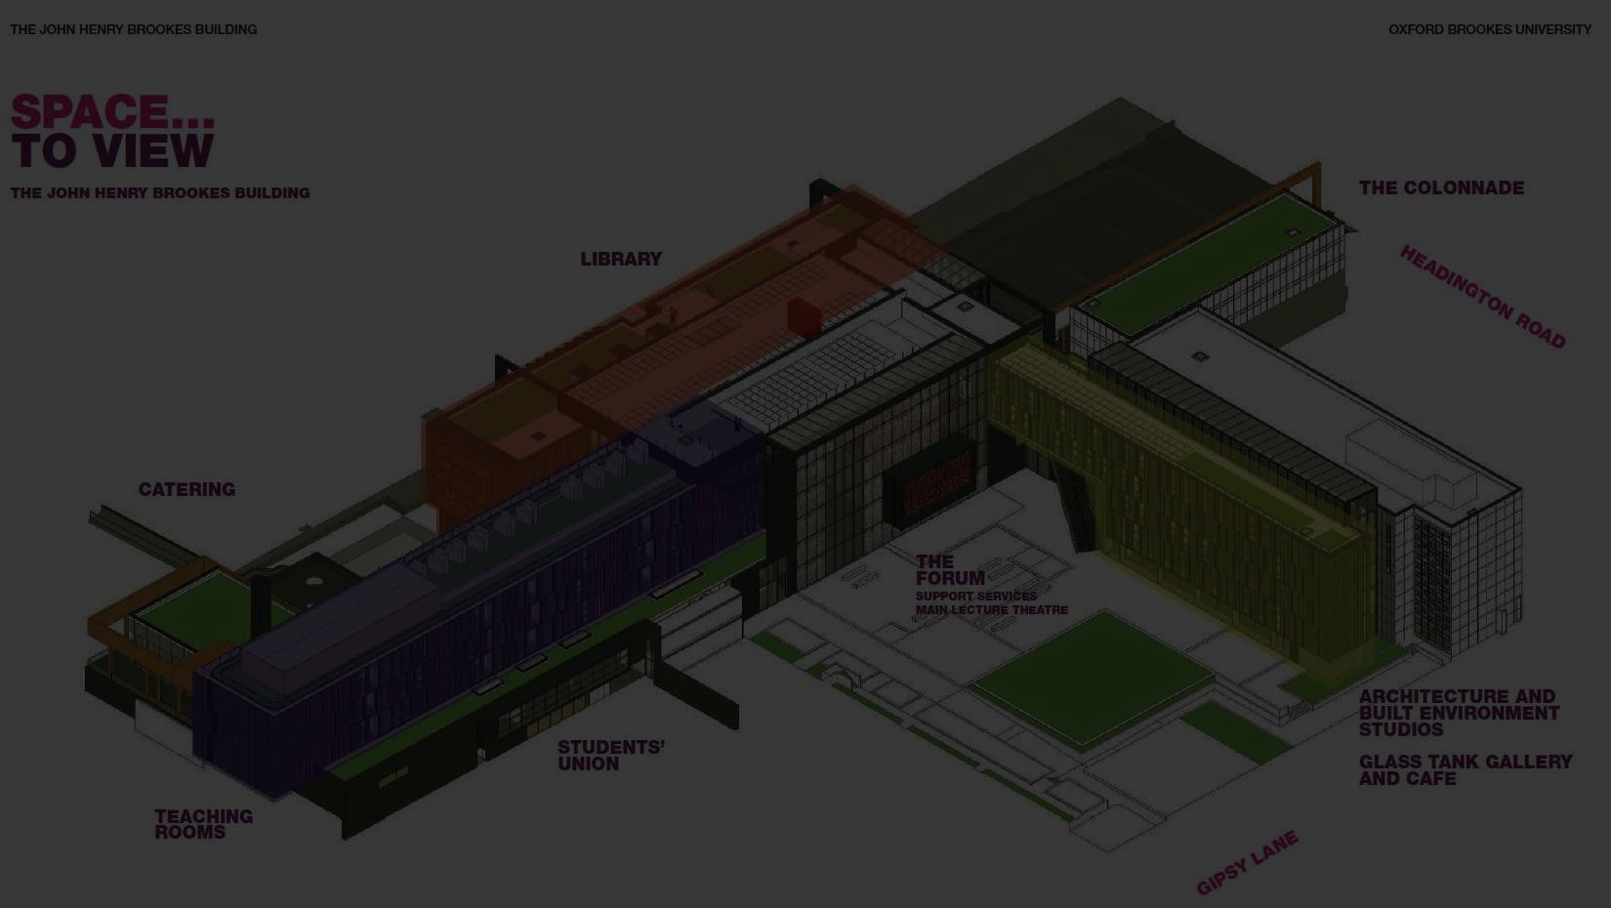
Space to think, or space to sink?
Oxford Brookes University Case-Study:
John Henry Brookes building:
http://www.brookes.ac.uk/Documents/Space-to-Think/jhbb-booklet/
‘Bring[s] together library and teaching spaces with social areas.’
Enables students to ‘work together and experience new ways of learning.’
‘The open-plan Forum, located at the core of the building will be the hub of the campus. It offers easy access to the support students need while providing an extension to the classroom and a comfortable place to take a break.’
‘It enables our students to work anywhere and be supported everywhere.’
‘The focus is flexibility and choice, with a great variety of spaces to support quiet research or dissertation work as well as areas for social learning or group projects.’

Slide 7
Space to think, or space to sink?
Seminar Activity:
“build your own learning space.”
Construct a ‘learning space’
with regards to your learning pedagogies.
Implement an effective, inspirational,
practical and flexible learning space.
Build a Higher Education environment for the 21st century!

Slide 8
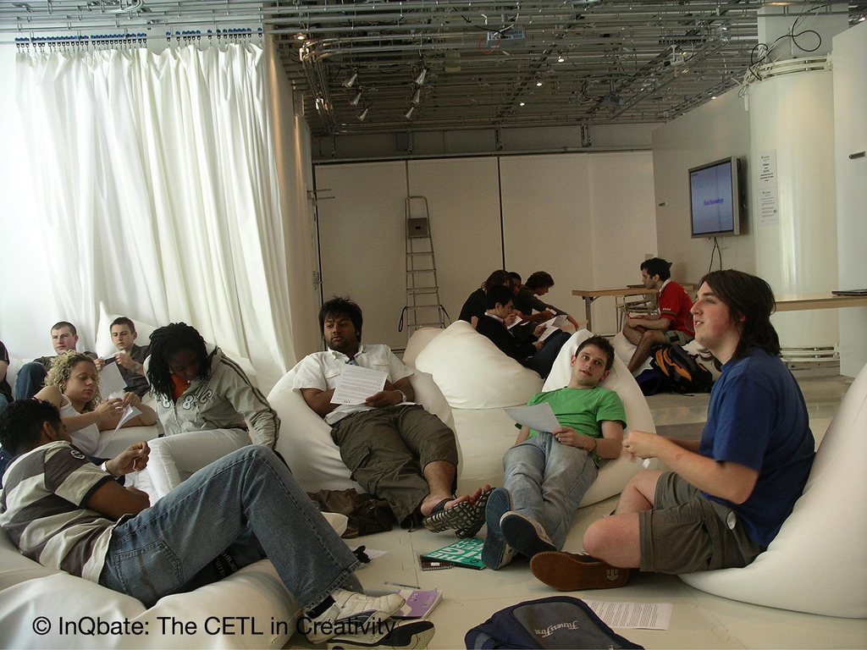
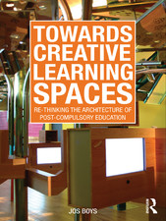
Space to think, or space to sink?
Conclusion: Evaluation, reflection and critique.
…criticisms of ‘flexible,’ ‘connected,’ ‘informal,’ ‘soft’ and ‘everywhere’ learning?
The work of Dr. Jos Boys, Towards
Creative Learning Spaces, (Routledge,
2011) critiques the
perceived authority of the
widespread culture of
informal learning spaces,
especially that proffered
by the JISC 2006 paper.
Right: contemporary example of a
‘learning space’ at Sussex University
illustrates the dominant model.

Slide 9
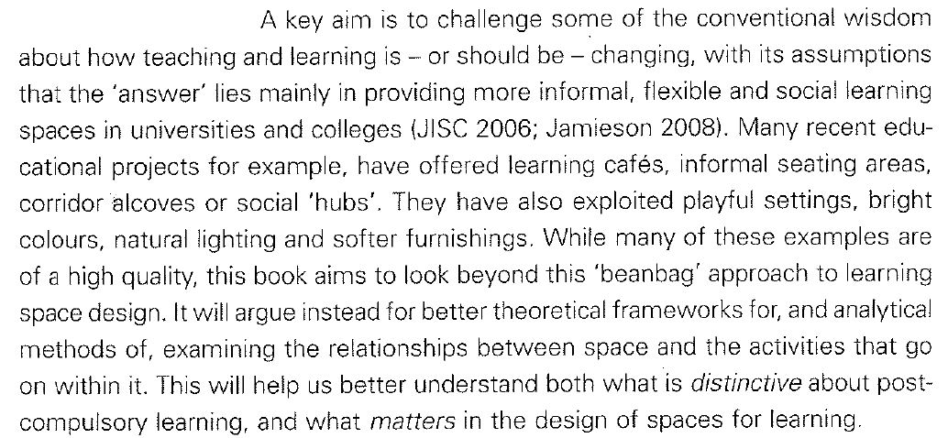
Space to think, or space to sink?
Conclusion: Evaluation, reflection and critique.
…criticisms of ‘flexible,’ ‘connected,’ ‘informal,’ ‘soft’ and ‘everywhere’ learning?
(Boys 2011, 1).

Slide 10
Space to think, or space to sink?
Conclusion: Evaluation, reflection and critique.
…criticisms of ‘flexible,’ ‘connected,’ ‘informal,’ ‘soft’ and ‘everywhere’ learning?
‘By rethinking how we conceptualise learning spaces and developing more rigorous but also more creative research methods we can begin to challenge the current tendency to think with rather than think about such broad-brush and generic concepts as flexibility, technology, colour and informality.’
‘…shifting from viewing (physical or virtual) space as a container or setting for learning activities where the hope is that ‘changing the scenery’ will affect behaviour. Instead, in line with much contemporary architectural thinking, space and its occupation are interrogated through their dynamic intersection as social and spatial practices. Space is not a thing but a process.’
(Boys 2009): http://arts.brighton.ac.uk/__data/assets/pdf_file/0019/64180/Jos-Boys-article-Networks08-pages-16-19.pdf

Slide 11
Space to think, or space to sink?
Conclusion: Evaluation, reflection and critique.
…criticisms of ‘flexible,’ ‘connected,’ ‘informal,’ ‘soft’ and ‘everywhere’ learning?
Space as a process is integral to re-thinking and re-working learning spaces because ‘current learning space design is based on simplified – and even idealistic or metaphorical – notions of learning space.’ (Boys 2011, 5).
Accordingly, what we need to comprehend is that architecture is not representational, ‘where meaning-making occurs through what we see in a space’:
Rather architecture is non-representational or ‘events-based’: ‘that is, meaning-making occurs through the activation of a space by our bodies.’ (Boys 2011, 6).

Slide 12
Space to think, or space to sink?
Conclusion: Evaluation, reflection and critique.
…criticisms of ‘flexible,’ ‘connected,’ ‘informal,’ ‘soft’ and ‘everywhere’ learning?
Mark Wigley, The Architecture of Deconstruction, (MIT Press, 1993).
Richard Coyne, Derrida for Architects, (Routledge, 2011).
Nikos Salingaros, Anti-Architecture and Deconstruction (Umbau-Verlag, 2006).
One type of related architectural critique is ‘deconstruction,’ where architectural thinking itself is revealed and a critiqued as a tool for making thought itself.
Wigley (1993, 212-3): ‘ … there is no such thing as a building outside of a large number of overlapping mechanisms of representation: schools of architecture, professional codes of ethics, critical practices, historiographical methodologies, academic protocols, pedagogical techniques, curriculum structures … [etc.] [Their] repetition constantly affirms the presence of architecture rather than analyzes it.’

Slide 13
INTENDED LEARNING OUTCOMES: Close
At this point you should have:
Consolidated your understanding of seminar pre-reading through discussion and a practical ‘design a space’ activity
Gained an understanding of the policies and pedagogies that influence design and use of learning spaces in HE
Acquired an understanding of the extent to which learning space requirements vary across disciplines
Applied this knowledge to a real life case study: the new John Henry Brookes building

