Slide 1
First Steps in Learning and Teaching in Higher Education
#fslt15
http://www.moodle.openbrookes.net/
Notes:
Hello Everyone.
Welcome to the First Steps in Learning and Teaching in Higher Education Open Online Course. We’re all looking forward to working with you.
In this brief presentation, I’d like to show you the sites that we’ve set up for this course and explain how and where we might interact with each other.

Slide 2
Learning Spaces
Your Own Spaces Tag with #fslt15 | Adobe Connect [Link] http://www.moodle.openbrookes.net/mod/equella/view.php?id=650
Moodle http://www.moodle.openbrookes.net/
Notes:
We’ve deliberately designed the course so that you can choose your own spaces and locations to work in. It doesn’t have to be one of the sites that we’ve set up – so if you do that you might like to tag your posts with the tag - #fslt15, so that we can find you, or provide us with a URL as a link to your site, and then we know where you are – that is if you want us to know where you are.
In addition to your own spaces we have set up two areas for interaction.

Slide 3
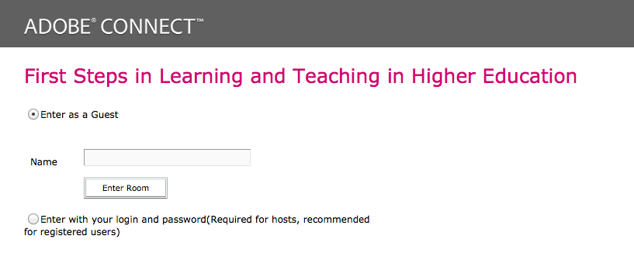
Adobe Connect
Notes:
Adobe Connect is the synchronous meeting site, where the live sessions will happen and where we’ll hear our guest speakers. The site is open. You should enter as a “Guest” and type the name you want to be recognised as in the “Name” box. Only presenters need to log in

Slide 4
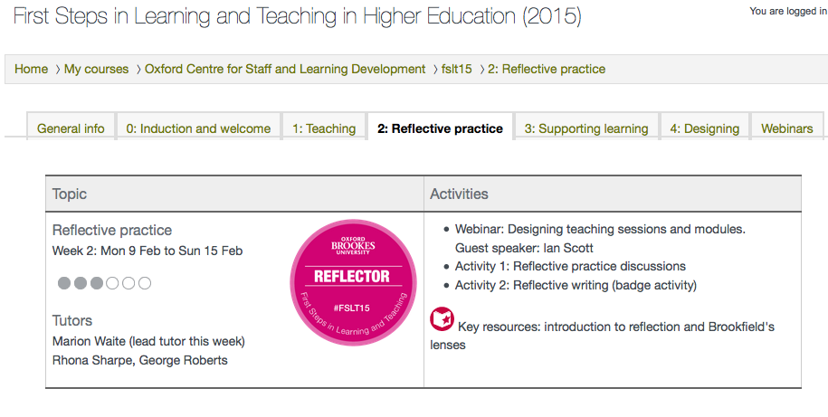
Moodle
Notes:
The Moodle site is where the discussion forums are and also where the main course content is. http://www.moodle.openbrookes.net
Moodle is the main teaching and learning space.
So if you are going to join us on this course and in these areas, what might you need to do?

Slide 5
Enrol on Moodle
Notes:
If you are going to join us in the Moodle forums on the Moodle site and access the content on the Moodle site, you need to follow the instructions for enrolling to the course on the Moodle page on the Wordpress site. You do need to enrol in the Moodle course if you want to post to the discussion forums. If you would prefer to use your blog rather that the discussions, you can paste a link to a post in your blog into the discussion forums or tweet it with the #fslt14 so others can find it.

Slide 6
Moodle Profile Settings
Notes:
And once you get into Moodle you might want to Edit your Profile, so that you get your settings just how you want them to be. The two areas I think are important are – the ‘Email digest type’. I only get a digest once a day, but by using the drop down box you can choose the setting of your preference – and the other important one is ‘Forum tracking’ – I always choose ‘Yes –highlight new posts for me’, so that I can see when new posts come in. But if you play around with those drop down boxes, you’ll get your settings to be just how you want them.
Finally – if you are going to join us in Moodle, you might like to start by posting a message in the ‘Arrivals Forum’, which is on the ‘Welcome to First Steps’ page – you can find this tab along the top of the Moodle page.
We’re very much looking forward to working with you and I hope that you’ve found this brief presentation helpful.

Slide 7
Moodle

