Slide 1
InstePP@BLTC
Intro
Educating Martha
Students’ Talks
Open Discussion

Slide 2
InstePP@BLTC
In
St
eP
P
stitutional
udent
…
ioneer
artnerships
Notes:
Institutional student e-pioneer partnerships is the name of the project

Slide 3
InstePP@BLTC
… seeks to create and embed a variety of staff–student partnerships…
Notes:
The InStePP project creates several distinct types of engagement opportunities between students and members of staff university-wide

Slide 4
InstePP@BLTC
… and, in so doing,
develop,
implement,
and exemplify:
Notes:
…with the goals of designing and enhancing…

Slide 5
InstePP@BLTC
1. Partnerships as an integral part of digital literacy development in the curriculum.
2. Digital literacies contextualized for disciplines and for career development.
3. Student roles and activities which support the development of staff digital literacies.
Notes:
PARTNERSHIPS as method of developing digital literacy in the academic curriculum, which as we know is a desired graduate attribute.
Different digital literacies CONTEXTUALISED for different disciplines.
STUDENT ROLES AND ACTIVITIES to support STAFF DIGITAL LITERACIES.

Slide 6
InstePP@BLTC
Engagement
Partnership 1
Partnership 2
Partnership 3
Engage in one or more partnerships over 18-24 months
•Keep reflective record of activities, experience, lessons learnt etc.
• Use records collated over time to gain academic credit and/or professional body recognition
Reward
Notes:
Looking at how student ‘ePioneers’ can work as agents of change in active, mutually beneficial partnerships with staff to:
• develop the digital literacies of staff and students across the University, within faculties and across programmes and courses
• embed digital literacy as a graduate attribute within programmes
• develop and enhance their personal and leadership attributes for employability.
Recognition pathways will include a) an ILM-endorsed programme of support, an ePioneer eportfolio, adapted from the CMALT portfolio framework, that aligns with ILM course requirements and a work and community learning related Independent Study Module.
I think that atop the professional recognition the academic recognition is perhaps more valuable to students; that e-pioneers can use their work in the project as an Independent Study Module, shows that their engagement is creditable and of importance.
So the first part of the project is recruiting students to engage with the institution as e-pioneers…

Slide 7
InstePP@BLTC
Are you looking to enhance your CV?
Want to develop your digital literacy and that of others while working in partnership with staff?
Would you like to have your contribution recognised?
If so, volunteer as a Student e-pioneer...
Notes:
The marketing of the project has mostly been by email, with a brief description of the benefits to students being sent out to all the students.
When students volunteer to become e-pioneers, much like I did, they are briefed with their responsibilities, and asked to sign the three-way contract, which summarises the initial partnership.

Slide 8
InstePP@BLTC
Five e-pioneer roles
Resource Creator
Trainer
Mentor
Researcher
Entrepreneur
Notes:
In the project, InStePP staff will provide opportunities for student e-pioneers to engage with members of academic staff across each faculty. This is done by enabling digital literacy-related commissions to be raised by staff, where e-pioneers can work with that member of staff to solve the commission.
There are five e-pioneer roles and all commissions should take the form of one of these roles. Each role is based on a digital literacy-context.
Something…
Move on to the 3wc…

Slide 9
< Back to contract
< Back to contract
< Back to contract
Student
e-pioneer
• Carry out partnership role
• University procedures and requirements
• Induction and workplace training
• Proactive teamwork
• Records and reflection
• Personal and professional development
• Fair recruitment process
• Agree hours and conditions
• Workplace induction
• Provide opportunities
• Training and development
• Health and safety, university procedures / requirements
• Review progress
• Guidance and support
• Liaise with Development Lead
Development Lead
Partnership Lead
• ILM-endorsed programmes
• ALT core skills framework
• Support reflections and feedback
• Recognition pathways and career development opportunities
• Academic credit and opportunities
• Progress and record keeping
• Liaise with Partnership Lead
Notes:
E-pioneers act as consultants in digital technology use for teaching staff at Brookes and agree the 3-way Contract at initial interview. The contract describes the key relationships in the partnerships – e-pioneer, Partnership Lead and Development Lead.
The Contract reflects that of the National Apprenticeship Scheme. Line management of an apprentice is discrete from formal learning provision and assessment, so an apprentice becomes the focus of two discrete role-holders: the Learning Provider (college), and the Employer (organisation).
In the resulting 3–way relationship, each party is a partner, as the outputs of the Apprentice are considered of equal value to the inputs of the Learning Provider and the Employer. Each party adds value in the mentoring, managing and enablement process that results in the recognition of the Apprentice as a developed and skilled worker in the chosen occupational area.
In the 3-way Contract, e-Pioneer substitutes Apprentice, with the e-Pioneer becoming the focus for development in both workplace-based skills, and relationship-building skills.
Partnership Lead Role (PLSE’s and DMeLD’s) substitutes the Employer role, with the Partnership Lead taking responsibility to line-manage the epioneer in a work setting, introduce the e-pioneer to the values, policies and practices of the work environment, ensure their safely and compliance with workplace rules and help them with the practicalities of contacts, space to work and appropriate tools for the job.
The Development Lead Role (reps in careers, OCSLD, Media Workshop etc) substitutes the Learning Provider, and takes responsibility for directing a learning process for the e-Pioneer that includes opportunity to use and enhance digital skills as well s a range of relationship focused skills and self awareness enhancement, to enable the effective delivery of the help they can offer to the staff at Brookes who will commission them as e-Pioneers.
The e-Pioneer enters into the contract to work with, rather than for, the persons who commission them: establishing the appropriate boundaries as partner and collaborator – as opposed to service provider, or “employee” - is a crucial learning element for the Development Role-holder to support. It is expected that the 3 parties fully understand the terms and conditions of the 3-way Contract before agreeing membership to the project: a representative of each of the 3 parties signs the agreement to ensure that that understanding is in place.
Student e-pioneer
• Carry out role description as agreed within the digital literacy partnership setting
• Abide by University procedures and requirements in a responsible way
• Participate in local induction and workplace activities as defined by your Partnership Lead
• Work as part of a team in a proactive way
• Take responsibility for recording and reflecting on personal, team and professional activity and development
• Participate in opportunities provided by Development Lead role for the duration of the partnership
• Contribute to InStePP dissemination activities (e.g. presentations, conference posters, faculty meetings and events etc.)
Partnership Lead
• Agree hours and conditions of work (e.g. location,
frequency of attendance etc.)
• Run an open and fair recruitment and selection process
(i.e. role description)
• Do workplace induction (e.g. health and safety, data
protection)
• Provide every opportunity for student to carry out the role
allocated and develop team relationships
• Set up relevant training and development in own systems
and practices
• Ensure a healthy and safe work environment in line with
University procedures / requirements
• Review progress against role requirements on a regular
basis and offer guidance and support
• Encourage and support inclusion into the wider team
• Liaise with Development Lead Role holder for review,
evaluation and development purposes
Development Lead
• Provide learning and support opportunities to enable
‣ critical self-awareness
‣ team leadership
‣ effective communication
‣ project planning and focus
‣ mentoring and guiding of others
‣ innovation and creativity
through interventions like Future Leaders, ILM-endorsed programmes, ALT core skills framework etc.
• Support reflective activity and feedback processes
• Develop and communicate recognition pathways and career development opportunities
• Encourage and support tracking of progress and own record keeping
• Liaise with Partnership Lead Role holder for review, evaluation and development purposes
• Explore academic credit and professional body recognition opportunities

Slide 10
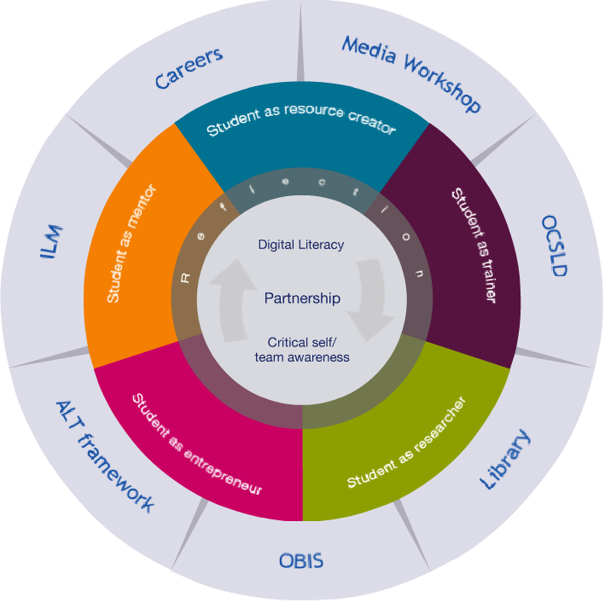
• Carry out partnership role.
• University procedures and requirements.
• Induction and workplace training.
• Proactive teamwork.
• Records and reflections
• Personal and professional development.
• Fair recruitment process
• Agree hours and conditions
• Workplace induction
• Provide opportunities
• Training and development
• Health and safety, university procedures / requirements
• Review progress
• Guidance and support
• Liaise with Development Lead.
• ILM-endorsed programmes
• ALT core skills framework
• Support reflections and feedback
• Recognition pathways and career development opportunities
• Academic credit and opportunities
• Progress and record keeping
• Liaise with Partnership Lead
Notes:
The development wheel explains in the broad context how…..

Slide 11
Notes:
So how do lecturers get involved in the partnership? Well, say there was a lecturer, he’s working in his office, he’s got lots going on, a big pile of old coursework outside his door..

Slide 12
???
Notes:
…and doesn’t know how to get it organised, got a frown on his face…

Slide 13
Notes:
…until he gets an idea…

Slide 14
Commission
Specification
Raise new InStePP Commission
Student
e-pioneer
Development Lead
Partnership Lead
Notes:
He can raise a commission, via e-mail, which then becomes a commission spec,…
The e-pioneers see the spec and volunteer to take it on. Still in the 3-way apprentice partnership, the e-pioneer forms a partnership with the lecturer as part of the working activity.
There is now another, distinct type of partnership created; in addition to the partnership defined in the three-way contract, between e-pioneer, partnership lead and development lead; a two-way partnership between an e-pioneer and a member of academic staff is created. The

Slide 15
Student
Staff

Slide 16
InstePP@BLTC

Slide 19
Scene I sound effects
KNOCK-KNOCK
Frank Look, I’ll have to go … There’s someone at the door…. Yes, yes I promise …
KNOCK-KNOCK 2
Frank (Calling in direction of door) Come in!
DOOR HANDLE RATTLING
Yes…. All right … Yes. … Bye, bye…. (replaces receiver) Yes, that’s it, off you pop.
(Shouting) Come in! Come in!
DOOR OPENING Martha I’m comin’ in aren’t I?

Slide 21
Scene II sound effects
Scene II sound effects
SQUEAKING AND DOOR OPENING
Frank You fixed the door! Excellent!

