Slide 1
Academic Posters
Get coffee > Head to a table (4 on each) > Pair up!
Starter Activity
In pairs, look at the posters around the room.
Make notes on post-its considering these 4 questions
Stick on to the relevant posters for others to view.
What is the research about? How do you know?
How effective are the images that are used?
How is the data visually communicated?
How does the layout tell the story of the research project?

Slide 2
Academic Poster Workshop
Learning Objectives
Develop confidence to organise visual and textual content
Use PowerPoint to layout an academic poster
Identify and apply the 7 design fundamentals
Select appropriate content for an academic poster

Slide 3
Why use an academic poster?
Highlights key elements of the research project
Reaches new audiences/ makes research accessible
Conveys more/ different information
Promotes design and use of engaging visuals
Synthesises research succinctly and rigorously
Activity 2
In groups, discuss and list the potential benefits of presenting research as poster

Slide 4
Examine a Poster
Activity 3

Slide 5
Examine a Poster
Content
Colour
Background
Font
Visuals
Accessibility
Layout
Activity 3
Look at the poster on your table
Examine strengths and weaknesses of the poster using the ‘7 design fundamentals’ postcard guides enclosed
Record and justify your findings on the flip chart paper
Each table will be asked to feedback findings, focusing on one design fundamental that could be developed

Slide 6
Content [postcard guide]
Title: clear, catchy, concise, informative
Word count: Relevant word count approx. 600 words
Balanced proportions: text, image and space
No abstract: the poster is an illustrated abstract
Author’s Details: Name and Brookes email address
Sub-headings or Thematic Titles:
Research question / aims
Research background, introduction or rationale
Methodology/ Methods
Findings
Conclusions and/or Discussion
References (2-5)

Slide 7
Colour [postcard guide]
Use colours that work together
Consider using Oxford Brookes University colours - lime green, pink and grey
Use 2-3 colours only
Avoid visually stressful combinations. Use good colour contrast
Consider the relationship between the colour of the text and the background

Slide 8
Background [postcard guide]
Allow generous margins for printing purposes
Allow space around boxes – this helps the reader to navigate
White is ok but off white and light grey are better for legibility
Keep the background plain

Slide 9
Fonts & Text [postcard guide]
Clear sans-serif font such as: Ariel, Helvetica or Verdana
Headings in same font: be consistent
Left justify text. (Occasionally centralised text can work)
Avoid italics, underlining and CAPITAL LETTERS
Line spacing of 1.5
Bold print for emphasis
No more than two fonts
Be consistent
Guide text sizes for an A1 poster:
Title - 85pt
Authors – 56pt
Subheadings 36pt
Body text – 24pt
Captions – 18pt

Slide 10
Visuals [postcard guide]
Visuals (graphs, charts or photos):
Serve a purpose
Include a figure title
Effective representation of data
High resolution suitable for A1 printing
Produce your own visuals or check for copyright

Slide 11
Accessibility [postcard guide]
Approx. 600 words
40% of the poster should be visuals
Leave plenty of space around your text, heading and images
Consider:
Flow - does it tell a story? Signposting with graphics to help the reader
Readability
Clarity – clear and concise
Intended audience
Coherence
Relevance
Labels
Design

Slide 12
Layout [postcard guide]
Avoid walls of text. Nobody will read them.
Improve the layout and keep the viewers attention with colour, boxes, and space.
Break up text with graphs, charts and images.
Use a portrait layout (for Get Published! entries).
Use a two or three column layout: Text across the full width of an A1 poster is too difficult to follow.

Slide 13
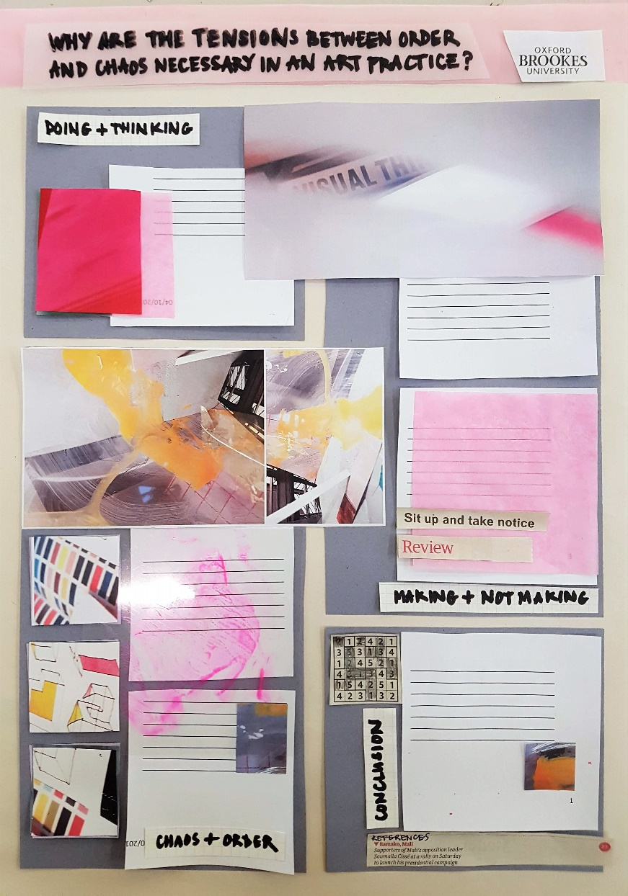
How to begin
Activity 4
Grab pens and A3 paper and sketch a layout
Consider:
What are my title and sub-headings?
How can I visually share my research? (i.e. use charts, graphs, photos, images)
What are the most important/interesting findings from my research project?

Slide 14
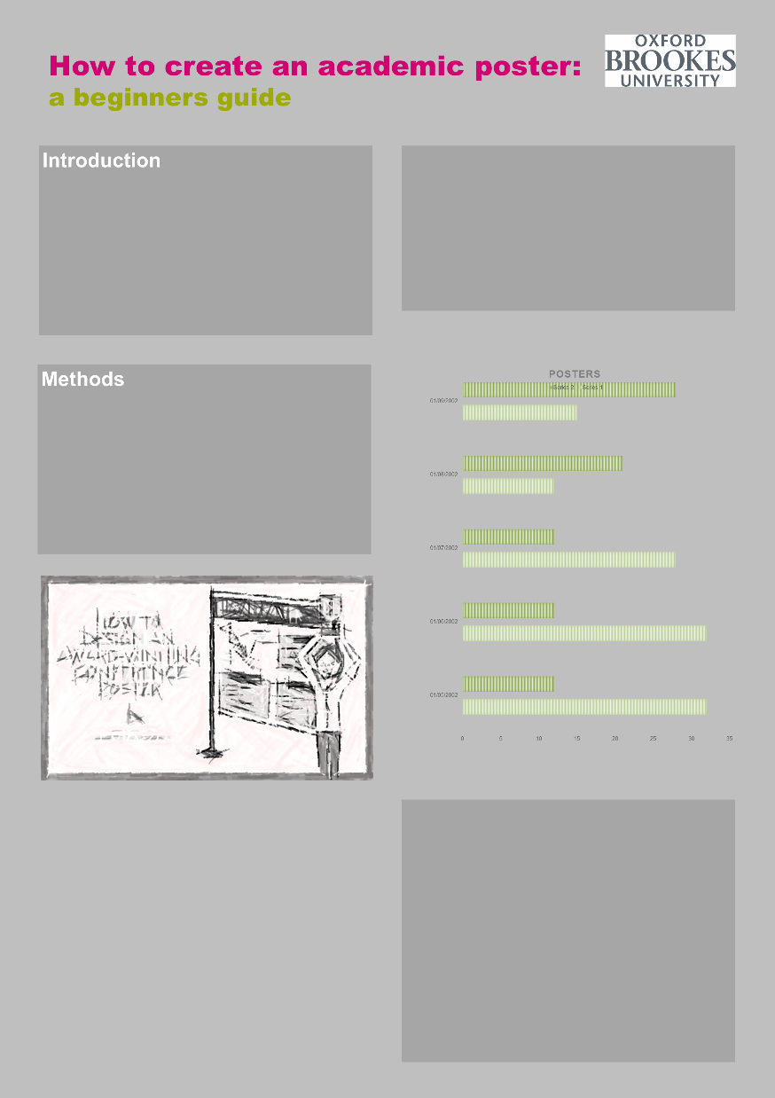
Design your poster
Activity 5
Open poster template in PowerPoint
Use handout to get started
Ask for help and help each other
Get designing!

Slide 15
Exemplar 1
Winner of postgraduate category
Get Published! conference
OBU, Aril 2018

Slide 16
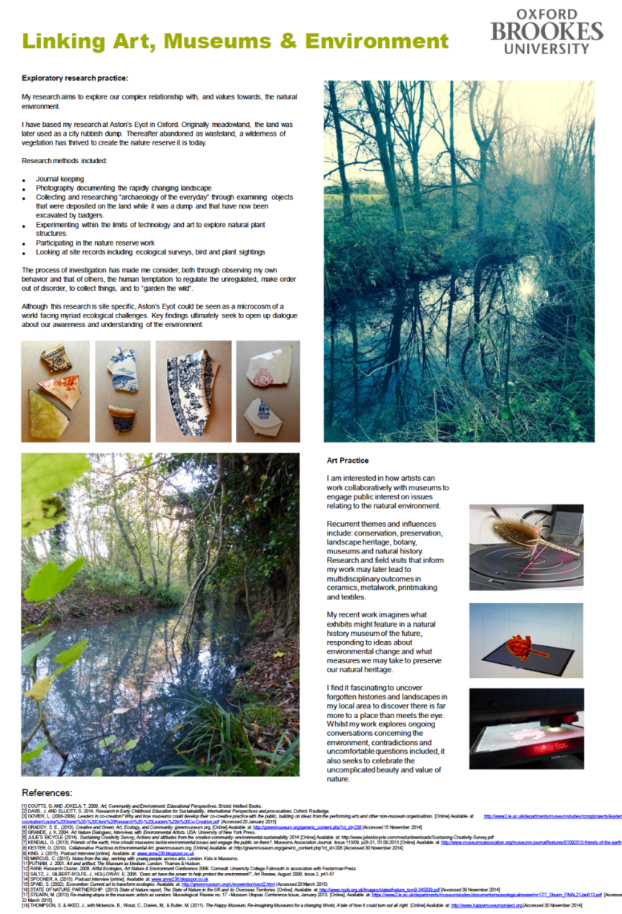
Exemplar 2
Winner of installation category
Get Published! conference
OBU, March 2017

Slide 17
Academic Poster Workshop
Workshop evaluation
Develop confidence to organise visual and textual content
Use PowerPoint to layout an academic poster
Identify and apply the 7 design fundamentals
Select appropriate content for an academic poster

Slide 18
Academic Poster Workshop
Workshop evaluation
Name:
Faculty:
What progress did you make in this session?
Please tell us what went well in this session:
Please tell us what could be improved in this session:
Do you have any ideas for further training and development with academic posters?
Develop confidence to organise visual and textual content
Use PowerPoint to layout an academic poster
Identify and apply the 7 design fundamentals
Select appropriate content for an academic poster

Slide 19
References
The URL for the copyright guidelines is:
https://www.brookes.ac.uk/library/library-services/copyright-guidelines-and-information/?acc=copyright11copyr11#publication
For further assistance please contact:
Katie Hambrook
t: 01865 483146
e: khambrook@brookes.ac.uk
Headington Library, JHB 310 (Level 3, Zone C)

