Slide 1
Challenges of Providing Information/Library Skills Sessions to Distance/Open Learners
Geoff Morgan
TeachMeet 2016

Slide 2
Definitions of distance learning
Distance Learning refers to geography.
Open Learning refers to time.
In other words
“Learning at a time, pace and place which best suits the learner.” (Fletcher, Learning et al. 2001)
Other terminology:
Autonomous learners
Off Campus Students
Non Traditional Students
ANY OTHERS?

Slide 3
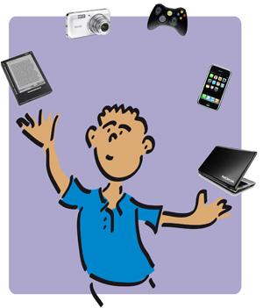
Challenges faced by distance learning students
“Distance learning requires as many eyes and arms as you can find” (Jones, 1998, p.27)
Will not have access on a regular basis to the services offered by the university.
Will not experience much , if any, face-to face contact with the university that s/he is enrolled.
Will quite often have other responsibilities.
Will have little contact with other students.
Will have to be proficient in the use of ICT and be adept at using audio visual equipment. (e.g. Adobe and Moodle)
In other words!
The student will have to be a competent juggler , with many eyes and arms and simultaneously an ability to keep her/his eye on the ball, thus retaining focus and motivation throughout the study of the course.

Slide 4
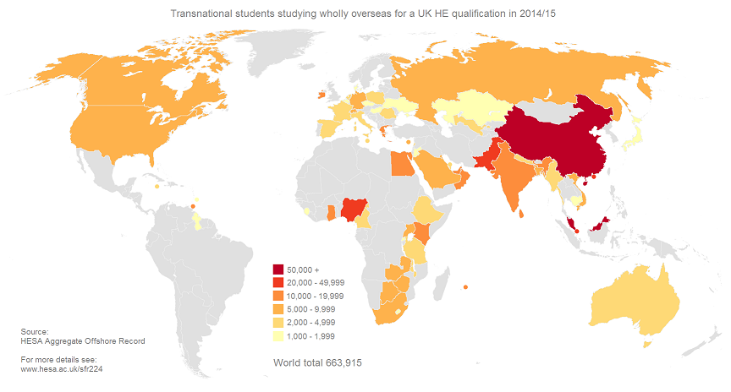
Students studying for a UK HE Qualification entirely overseas
(HESA, 2016)

Slide 5
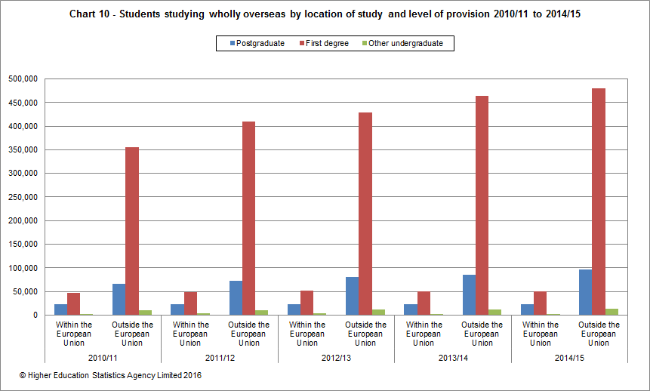
Students studying entirely overseas by location 2010 - 2015
(HESA, 2016)

Slide 6
Courses which I Support
Real Estate Investment Finance (REIF)
Project Management in the Built Environment (PMBE)

Slide 7
New courses Starting in 2016
MSc Quantity Surveying
MA in Humanitarian Action and Peacebuilding

Slide 8
How I support the students for MSC project management in the Built Environment (PMBE)
Provide information/library skills sessions as a part of a study week. (Face to face)
Attend a meal usually held at the First Floor Restaurant Cowley Road. (Face to face)
Invited to attend workshops and participate in course workshops. (Face to face)
Add information for distance learners on subject guide. Point students to generic library guides
Any other suggestions?

Slide 9
How I support the staff for MSC PMBE
Attend Subject Committee meetings and annual reviews (advice on scanning, Aspire, e resources)
Attend Away days
Attend a meal usually held at the First Floor Restaurant Cowley Road
Meet informally for coffee/tea

Slide 10
How I support the students for MSC Real Estate Investment Finance (REIf) (New Course which started in 2015)
This is a new course so it is still evolving and in contrast to the PMBE the students do not have the chance to visit Brookes.
Participate in an open day using Adobe Connect.
Provided a session on referencing using Adobe Connect.
Provide help via email and elsewhere as requested.
Other suggestions?

Slide 11
How I support the staff for MSC REIF
Attend Subject Committee meetings and annual reviews
Invited Academic staff setting up the programme to find out what their requirements are and how the library can support the students.
Meet informally for coffee/tea
Provide details of how non fee paying students can obtain information for their course. Advising freely available information sources.

Slide 12
Reflection on challenges with MSC REIF
Students are based entirely overseas mainly in South East Asia with English as a second language – lesson plan to simplify library jargon.I tend to avoid terms such as Boolean; Zoe and Dimartino (cited in Hughes, 2002, p.209) suggest that this is helpful to those whose “native language (eg Chinese ) has no function words including the conjunction ‘and/or’” i.e. mindful of cultural differences
Faulty equipment! Headphones, microphone, computer, software etc.. Check beforehand!
Not all students are fee paying so do not have access to Brookes paid for subscriptions or ebooks.
Library skills have to be provided using Adobe Connect or similar technology
Advice can be given by email and has worked well but making sure who has access to the Brookes resources can be challenging.

Slide 13
Where do we go from here? Going the distance
What is the Potential for Growth in Distance Learning? (see slide 5)
What other technologies are available? “In this technological age the next generation cannot work without using digital gadgets and growing technologies” (Hafeez et al, 2014, p.177)
A system for providing library support? (Adobe, Chat, Social Media etc.) “Social networks like Face book, Twitter and LinkedIn may be used for developing better networks between peers and academics” (Hafeez et al, 2014, p.177).
What do you do?

Slide 14
Services to Distance learners provided by other university libraries
“The Open University the largest UK’s distance education provider is developing disabled user support to meet the needs of its large and growing disabled student population (Mears and Clough, 2015, p.73). http://www.open.ac.uk/library/
Sheffield University https://www.sheffield.ac.uk/library/services/dls
Lancaster University http://www.lancaster.ac.uk/library/information-for/distance-learners/
Aberystwyth University https://www.aber.ac.uk/en/is/help/distancelearners/#d.en.69468

Slide 15
References
Fletcher, M. (2001) 'Distributed open and distance learning: how does e-learning fit? Learning and Skills Development Agency, London (England) available at: http://www.ldasa.org.uk/files/pdf/R1161.pdf (accessed 8 June 2016).
Hafeez, A., Ahmed, A. and Zubia, N. (2014) 'Demanding need of growing technologies in distance learning system', Turkish Online Journal of Distance Education, 15(4), pp. 170-180.
HESA (2016) Statistical first release 224 - student enrolments and qualifications. Available at: https://www.hesa.ac.uk/sfr224 (accessed 8 June 2016).
Hughes, H. (2002). Information literacy with an international focus. In: Lifelong Learning Conference 2002. Rockhampton, Queensland, Central Queensland University Press,, pp.208-213.
Jones W.G. (1998) Transforming libraries: issues and innovations in distance learning, Association of Research Libraries, Washington D.C.
Mears, W and Clough, H (2015) Online library accessibility support: a case study within the Open University, Open Learning, 2015 Vol. 30, No. 1. available at http://dx.doi.org/10.1080/02680513.2015.1025735 (accessed 8 June 2016)

Slide 16
Links
Digital and Information Literacy Framework (Open University) http://www.open.ac.uk/libraryservices/pages/dilframework/
Standards for Distance Learning Library Services (ACRL) http://www.ala.org/acrl/standards/guidelinesdistancelearning

