Slide 1




Making sense of Open Access
A tale of three modern universities
Rowena Rouse,
Scholarly Communications Manager.
Oxford Brookes University
Jisc OA Pathfinder project: Making Sense – a researcher centred approach to funder mandates

Slide 2



Setting the Scene
Staffing | Library – 4 Research Support Librarians support from 3 Metadata Librarians | Academic Liaison Librarians Scholarly Comms Manager + 1 Assistant | Research Outputs Manager (based in Research Office 2 days pw) Research Outputs Officer 0.6 Research Outputs Assistant
Resources | BG = £15,767 £40,000 to support OA | BG = £16,000, no publication fund | BG = £34,000, publication fund
Systems | Repository = Eprints | Repository = Equella CRIS = Converis | Repository = Eprints CRIS = Pure
Organisation | No Central Research Office but 3 College Research Teams | Central Research Office | Central Research Office

Slide 3
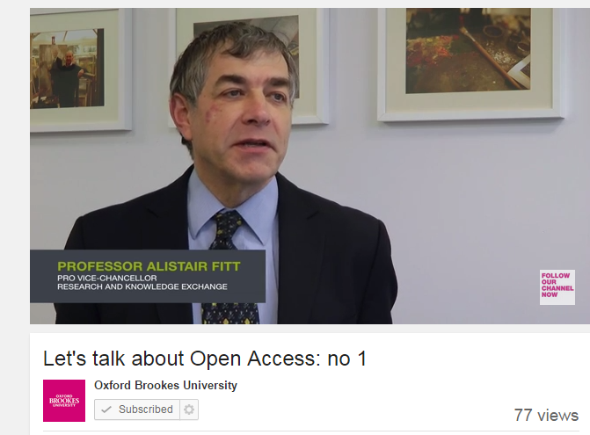
Advocacy – how to make it work for your institution
Relationships/Partnerships – senior management
support, effective communication channels
Post Ref Roadshows – Autumn 2014
15 Roadshows
Autumn 2014
  15 Roadshows

Slide 4
OK – but what do *I* have to do?
ANSWER – basically just one thing:
When your paper or conference proceeding output is accepted, post the postprint on the CRIS
In a minute, I’ll show you how to do this, but first...

Slide 5
Advocacy – how to make it work for your institution
Timeliness and Continuity
  bookmark reprinted
  generic email: openaccess@brookes.ac.uk
  ethnographical interviews
  Grand Tour
        Tell me about your research .
        How do researchers communicate their research?
        What triggers them to publish?
        How do they choose where to publish
      Mini Tour
        What are you working on the moment?
        How has the experience been so far?

Slide 6
Advocacy – how to make it work for your institution
Remember why we are doing this
Systems in place

Slide 7


Tools to support Advocacy
Baselining
CIAO is a benchmarking tool for assessing institutional readiness for Open Access (OA) compliance.
Download from http://bit.ly/1ElNlKY
The tool is based on the CARDIO (Collaborative Assessment of Research Data Infrastructure and Objectives – http://cardio.dcc.ac.uk).

Slide 8
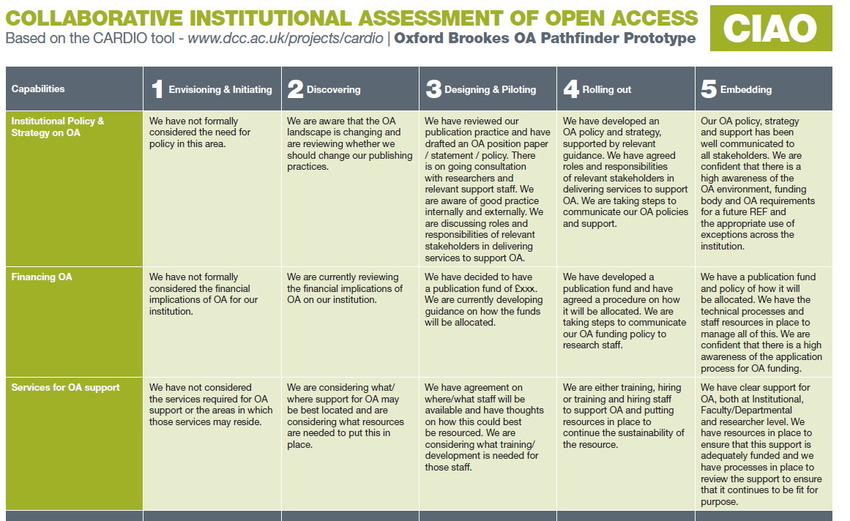

Slide 9
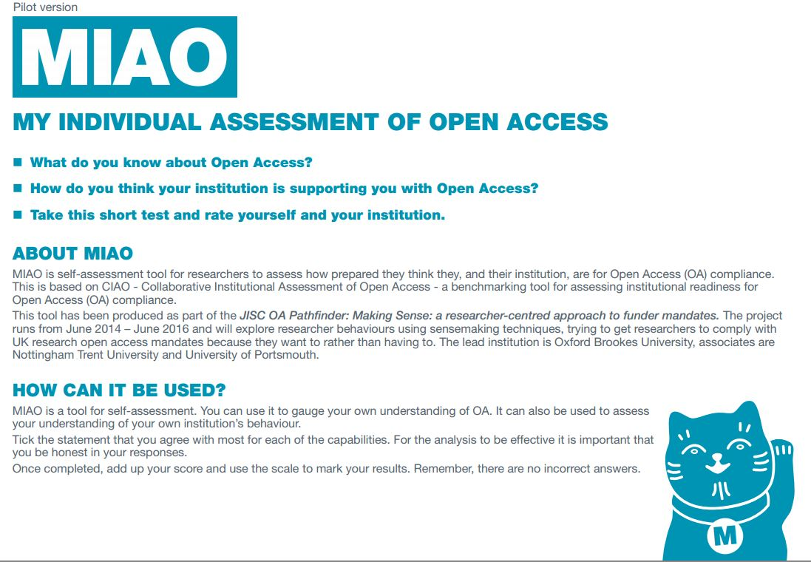
Download from http://bit.ly/1DCmlW9

Slide 10
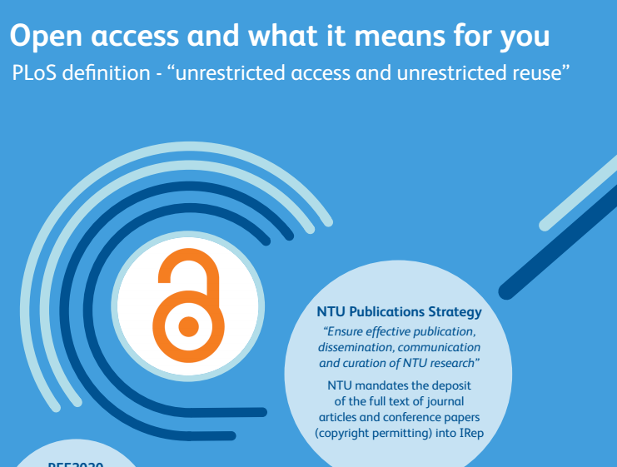
Tools to support Advocacy
poster from NTU – http://bit.ly/1NsNVZI

Slide 11

Tools to support Advocacy
Edited Hefce poster – Portsmouth – http://bit.ly/1Uk294P

Slide 12
Uncovering researcher behaviours and engagement with Open Access #oagp
Tools and techniques for effective understanding and communication
CIAO
MIAO
Interview Questions, interview coding from Nottingham Trent
Hefce poster – Portsmouth
Researcher Lifecycle – Northampton
Open Access and your published paper – Northampton
Intervention Mapping tool - Coventry
www.brookes.ac.uk/library

Slide 13
More information
See how we make sense of it all –
follow this blog:
http://sensemakingopenaccess.blogspot.com/
Open Access webpages
http://www.brookes.ac.uk/library/research/resopen.html
http://www.ntu.ac.uk/library/research_support/open-access/index.html
http://www.port.ac.uk/library/help/research/open/

