Slide 1
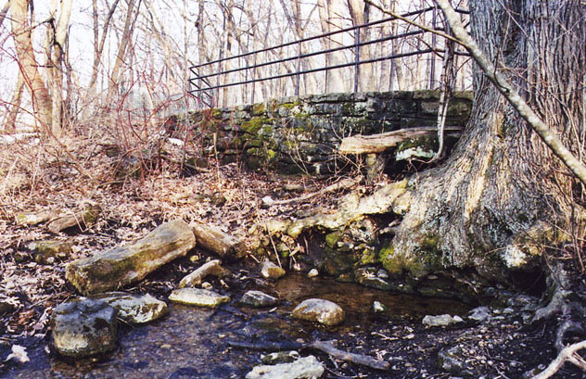
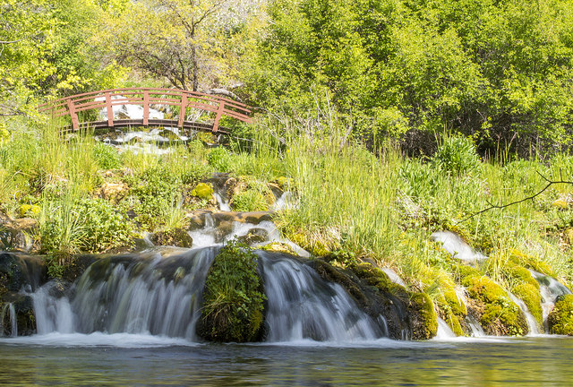
Finding The Best Sources
Hazel Rothera
Education Librarian
Emily Mills on Flickr Commons
Aaron Hawkins on Flickr Commons
Storm Crypt on Flickr Commons

Slide 2
What’s this session for ?
Module aims: … role of educational research… validity and reliability of a range of contemporary evidence that underpins the professional knowledge of primary school teachers… grounding in criticality
Assignment: Find a news event from the summer or recent past and explore what the underlying educational themes are, and how educational research can help us understand it.
Rest of the course: What you learn from this module you should apply in and across the other modules you take in your programme.
Your future career: to help you debate with parents, head teachers, school governors, and Secretaries of State for Education!

Slide 3
We all like information to be…
Short
Easy to find
Easy to understand
Up-to-date
Evidence-based
Accurate and unbiased
Detailed
… but no information source can be all those things at once!

Slide 4
One-minute exercises: which are the most important 3 in each of these scenarios?
Information to help you with…
Easy to find
Choosing a restaurant to organise a meal out for a friend’s birthday
Short
Easy to understand
Evidence-based
Helping your gran decide whether to have a particular operation
Up-to-date
Accurate and unbiased
Writing an assignment for this course
Detailed

Slide 5
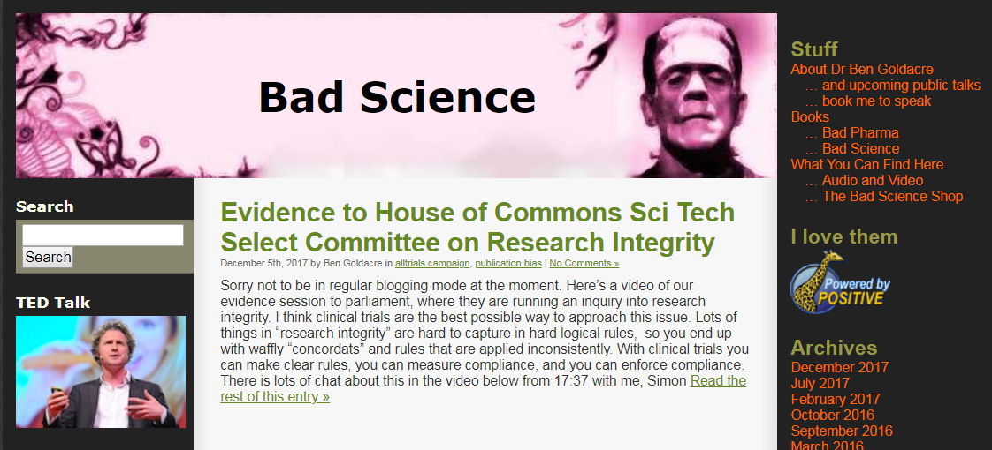
Information sources are not all the same!
Newspaper by Ann Christin on Flickr Commons

Slide 6
Google Is Not Your Friend…
… most of what you’ll find with a quick Web search is not academic information
… Google puts the most popular, not the most accurate or correct, Web sites at the top of its search results (Google makes its money by getting you to click on ads!)
… often companies pay for their sites to come at the top
… controversial social media posts & articles (clickbait) rank highly but are much more likely to be fake (or biased) news
… To get accurate, reliable information, and do well in your assignments, you’re going to need credible academic sources…

Slide 7
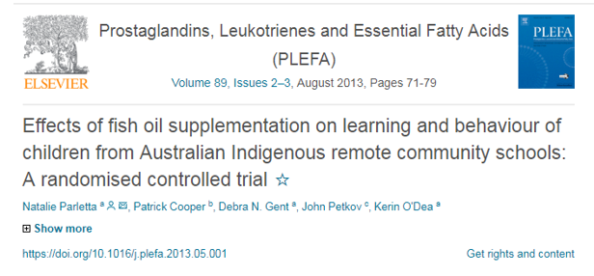
Group exercise – rate these sources Each group has:
An academic journal article
Pass round and quickly skim-read (you won’t have time to read in detail) each of the sources.
Then as a group, rate each one on the scoring grid you’ve been given, for each of the criteria
Scores can be Very, Quite, or Not at All
For example, is the blog post Very detailed? Not at all easy to understand? etc.
You have ten minutes!
A newspaper article
A blog post

Slide 8
So what ARE reliable academic sources?
Textbooks
General grounding in a topic
Chapters on different aspects
Established knowledge
Encyclopedias
Overview
Introduction
Well-known facts
Journals
Publish several issues a year
Range of articles in each issue – research, opinion, news
Some are “peer-reviewed” – a badge of academic quality. Most journals tell you this either inside the front cover or on their Web site.
Journals contain…
Journal articles
In-depth examination of a topic
May report on a research study
Cutting-edge in their field

Slide 9
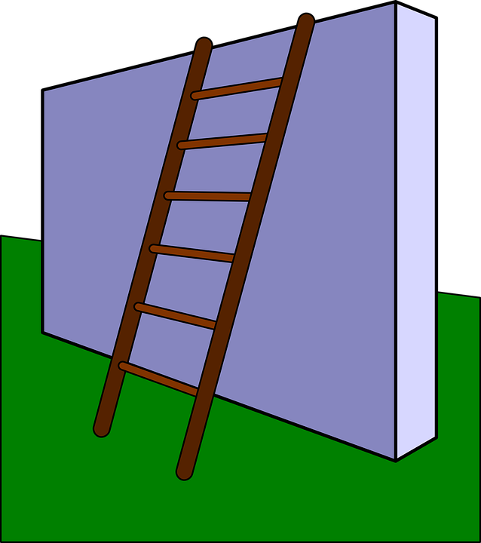
But I can’t understand the journal articles…
…until you can understand the in-depth research findings.
Research is mostly reported in journal articles
… read article abstracts
Abstracts are summaries of the key points of a journal article
…get the background from a textbook…
… use a dictionary to learn any words you’re not familiar with…
Textbooks from the Library
Look in our Quick Ref section or online
Read a basic but reliable introduction to the topic…
(good quality Wikipedia article, encyclopedia entry, reliable Web site)
… then you’ll need to work your way up the information ladder!

Slide 10
You’ll probably be told that you can’t cite blog posts, Wikipedia articles, etc in your assignments (they’re not sufficiently robust sources of evidence) .
But you may need to read them in order to then understand journal articles and other research – which you can cite.
The academic sources which end up cited (referenced) in your assignments may only be the tip of your reading iceberg!
Kils & Bodo, commons.wikimedia.org

Slide 11
Books, reports, journals and journal articles are all easy to find…
(demo)

Slide 12
Practise finding these on LibrarySearch…
The e-book of Judith Bell’s Doing your research project
A book by Denis Hayes on primary teaching
A peer-reviewed journal article, published in the last 5 years, on outdoor learning in the early years
An article from the current issue of British Educational Research Journal

Slide 13
Two-minute Reflection…
(We will summarise the responses for you on Moodle – fill in and pass to the front: )
The most important thing I have learnt in this session is…
One question I still have is…
As a result of this session I will now go away and…

Slide 14
And finally, remember…
Not all information sources are the same – choose wisely!
Expect to have to work at climbing the information ladder to reach the best sources…
… which means the academic sources you reference in your assignments may be only the tip of your reading iceberg!

