Slide 1
How to use your Turnitin Report
I think it is a very positive tool that enhances student learning. It can be used for the purposes of developing and learning on how to write assignment in the proper way.
I found that very useful tool to see where I am going wrong and if there‟s anything I can correct the referencing and citations.
The Turnitin programme “caught” me few times. I just realised that I forgot to put quotations or references [unintentional plagiarism].
This is a very good tool for students to learn how to progress and develop assignment writing.
Price, T. & Chew, E. (2011) Using Turnitin, Grademark and Peermark in assessment for learning: students’ positive experiences of using Grademark. Available at: http://www.plagiarismadvice.org/resources/item/price-gm-positive-experience-transcript (Accessed 15 October 2014)

Slide 2
Overview
What is ‘Turnitin’?
How to interpret your Turnitin report
Common mistakes and errors
Sources of help
Notes:
This short video introduces you to the basics of how to interpret a Turnitin report. The aim is to:
Introduce you to Turnitin and explain why we use it
Go through some real examples of Turnitin reports to show you how to interpret the information
Identify some common errors that students make when trying to reference correctly
Signpost some further sources of help

Slide 3
What is Turnitin?
Turnitin is a ‘text matching’ or ‘plagiarism detection’ software
It is used as a developmental tool for students and to help staff detect plagiarism and copying
A high similarity match does not necessarily mean plagiarism or copying. It could be because:
there is an overuse of direct quotations within the work
common phrases or series of words are being used that are the same
A low match does not necessarily mean that cheating has not occurred
some sections (albeit small) may be plagiarised or copied
there are increasing sophisticated methods….
Notes:
So, what does a Turnitin report look like?……..

Slide 4
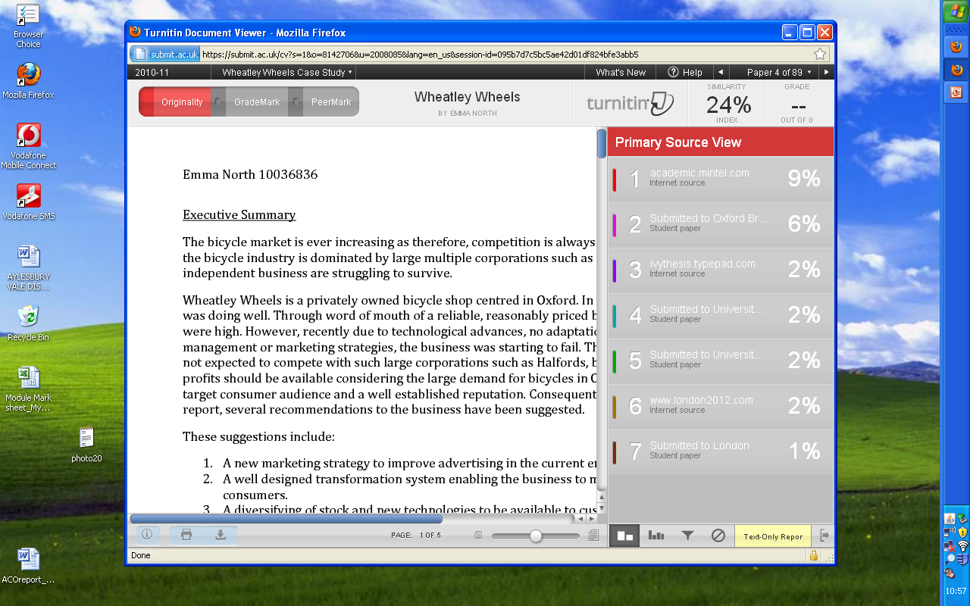
Notes:
This is an example of what you will see once you open your Turnitin Report
The text on the left hand side is your report
On the right hand side you will see the ‘Primary Source View’ – this show the sources that parts of your assignment have matched with. Note that they are colour coded so that you identify the sources within your report more easily. I will talk more about this later.
So, how do you interpret your turnitin report?

Slide 5
This shows how much of your assignment ‘matches’ text in the Turnitin database

Slide 6
This shows that 9% matches a Mintel Report
Notes:
….to find out what the match is then scroll down the Turnitin report using the vertical blue scroll bar until you find text in your report that is highlight in red (as this is the colour code for this source). Alternatively you can click on the source name itself in the Primary Source View

Slide 7
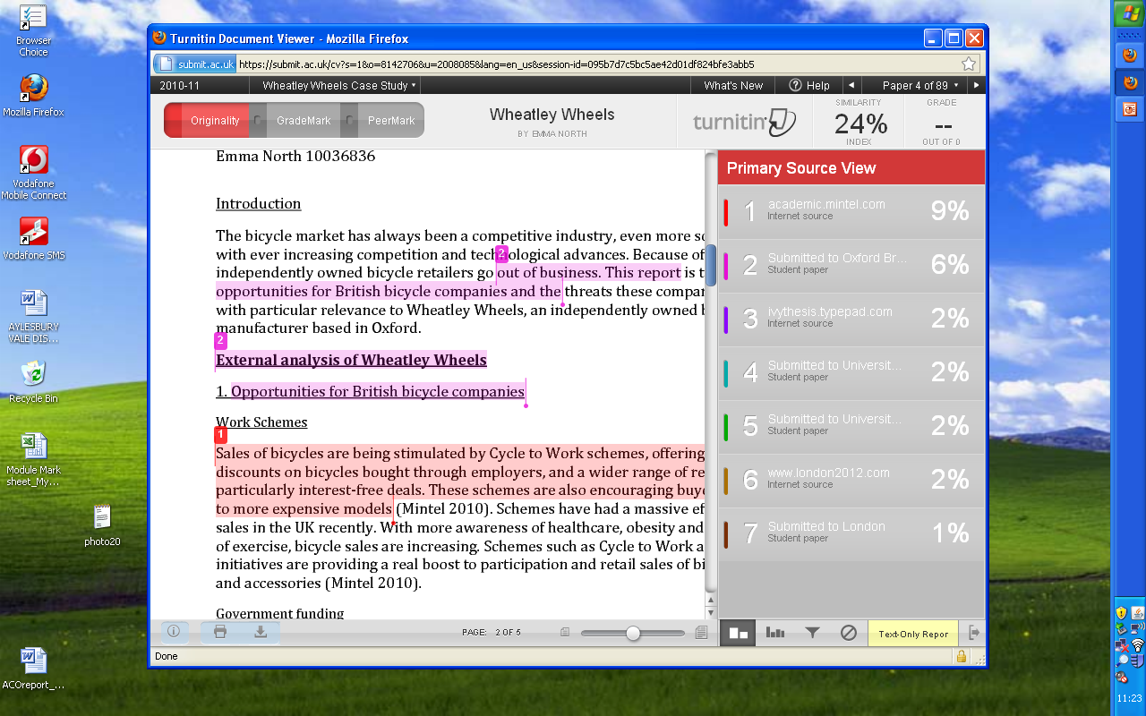
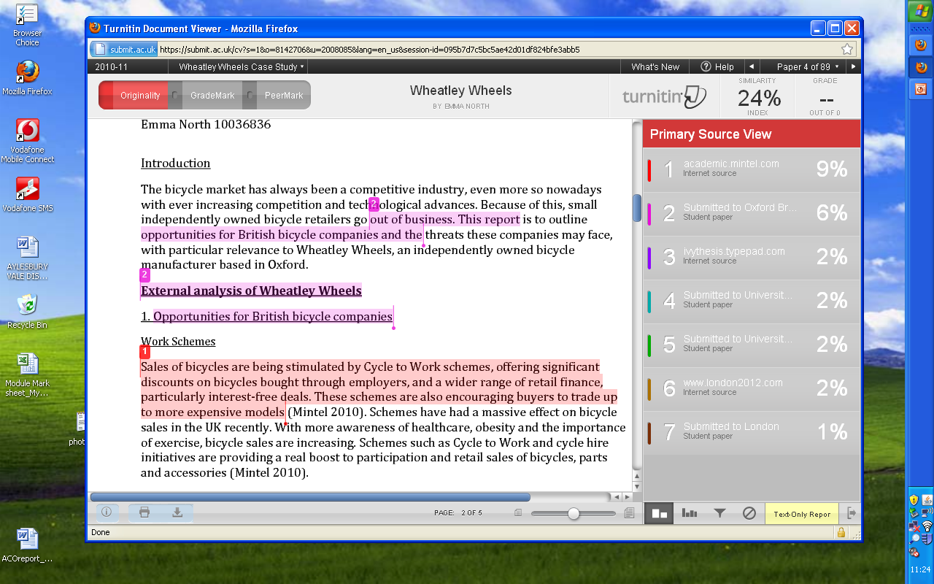
This is a section of your report which matches text within the Mintel Report
Notes:
To find the text in the original Mintel report then click on the number 1 in the small red box above the red shading

Slide 8
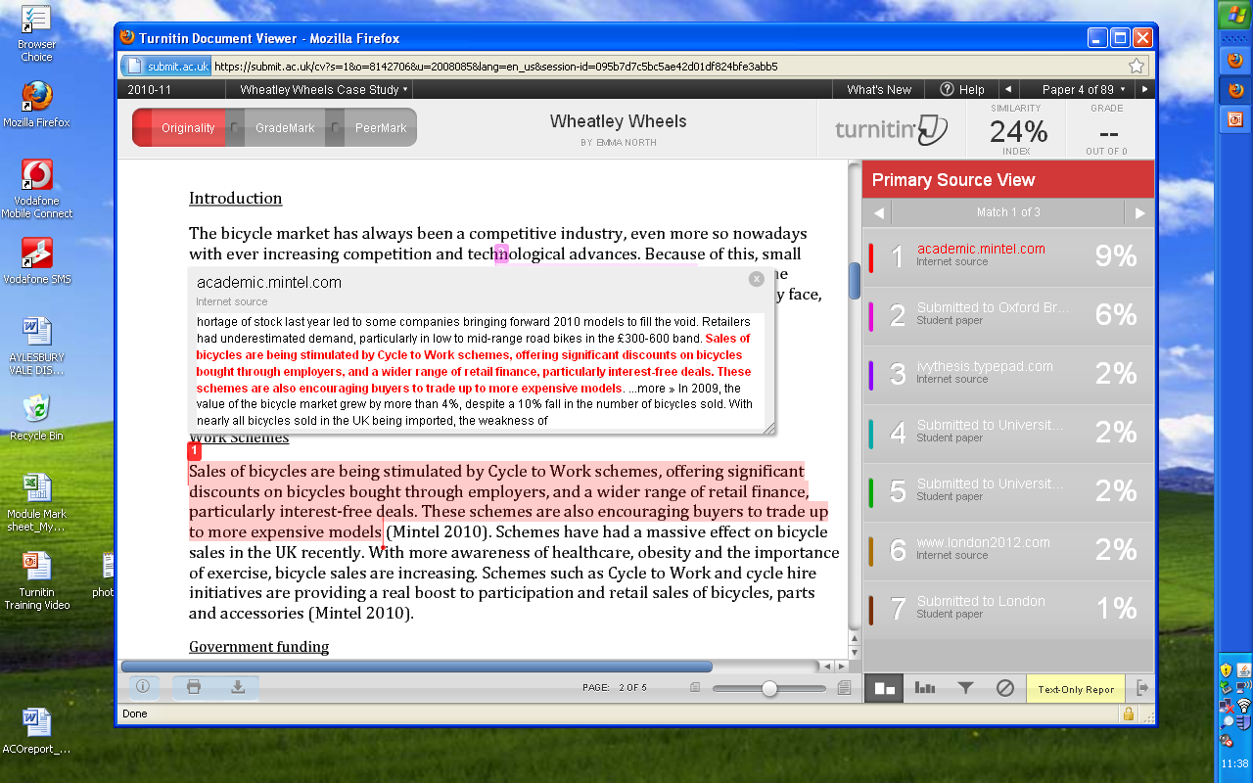
Notes:
As you can see, the text in the student report matches exactly the section of text in the Mintel Report.
Whilst the student has indicated the source of the work – Mintel 2010 – the text is not in speech marks to denote that it is a direct quote. Remember, a direct quote is when you use somebody else’s words verbatim. You are allowed to do this but you must acknowledge this properly according to your referencing guidelines.
Now compare this to a student who has used a direct quote but has referenced it properly…..

Slide 9
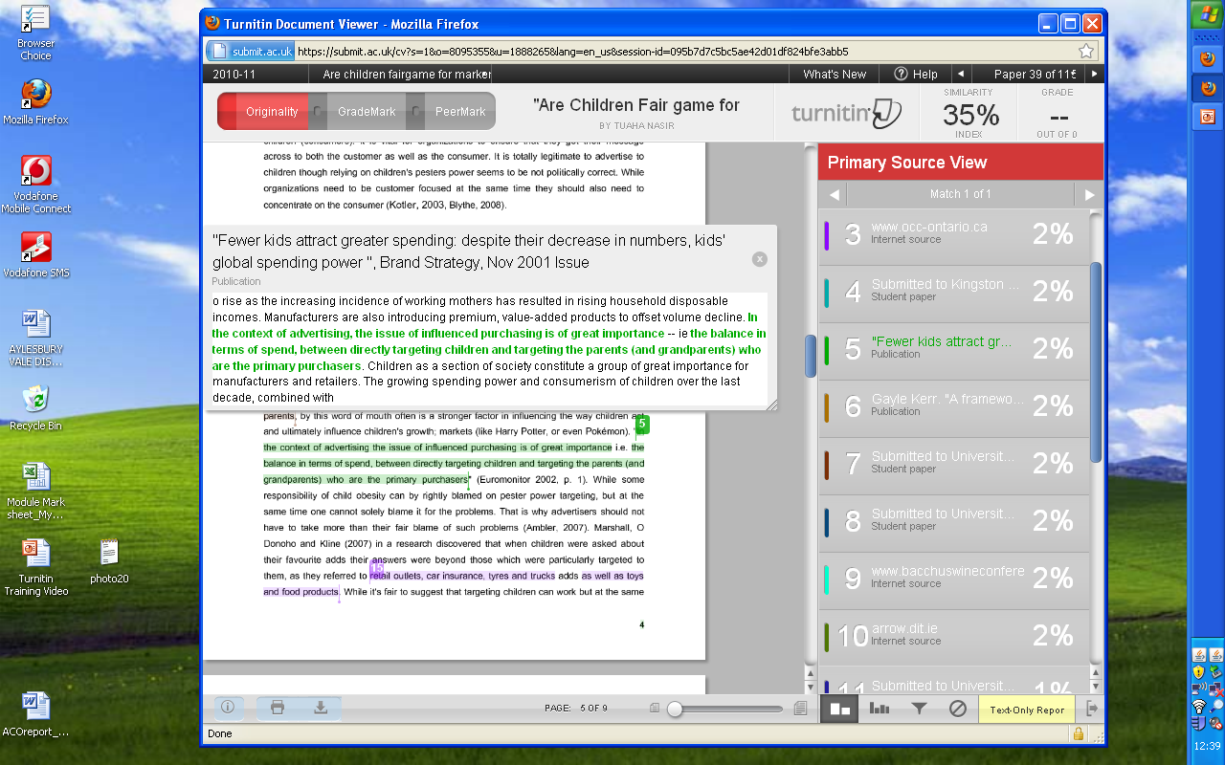
Notes:
Although it is still showing as a match and counts in your overall similarity index percentage, the work has been referenced correctly it is therefore not plagiarised……….This match would not be taken in to account by your tutors when interpreting your Turnitin report.

Slide 10
This shows that 6% matches an assignment submitted to Oxford Brookes University by another student
Notes:
Let’s go back to the first piece of work we were looking at. As mentioned at the beginning of this presentation, Turnitin also stores work submitted by other students at your University or institution. This helps your tutors identify any potential sharing and copying of work.
Of course, some matches are just common phrases such as the next example…

Slide 11
It is likely that another student on your course completing the same assignment has written the same series of words
Notes:
…in which case that is fine. If there were a number sentences that were identical then this would indicate a problem. For example, take a look at the following example….

Slide 12
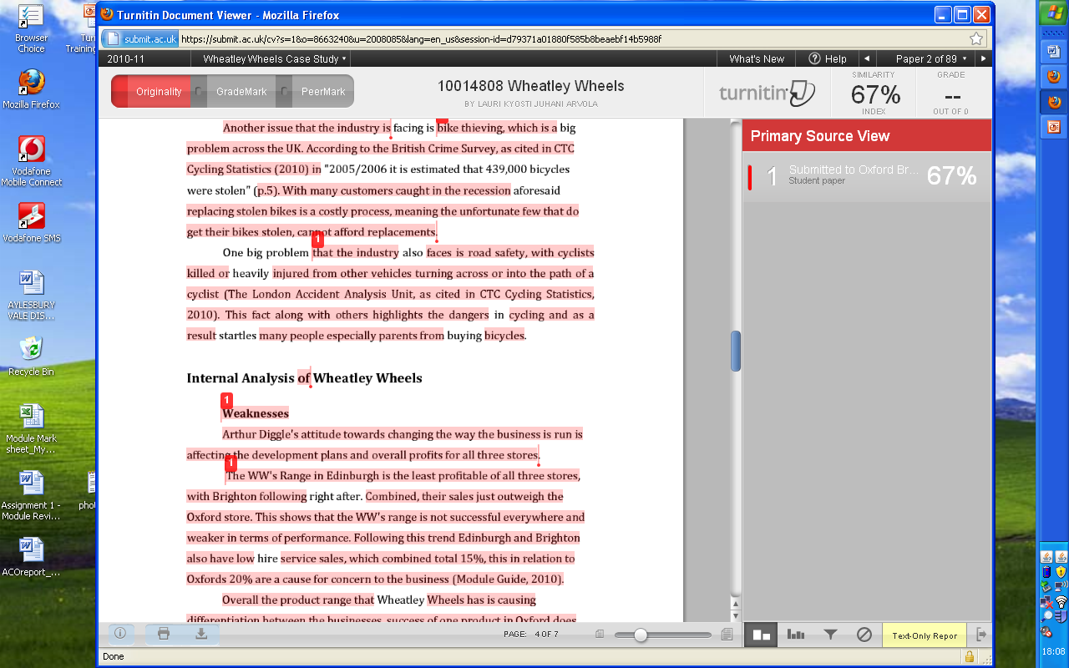
Notes:
This student has interjected or changed the occasional word/phrase in to text that is heavily matched. The Primary Source again is student work submitted to Oxford Brookes University. However, these are not common phrases or coincidental series of words. This would require further investigation by your tutors.
A common problem we do see is poorly paraphrased worked. Take the next example……….

Slide 13
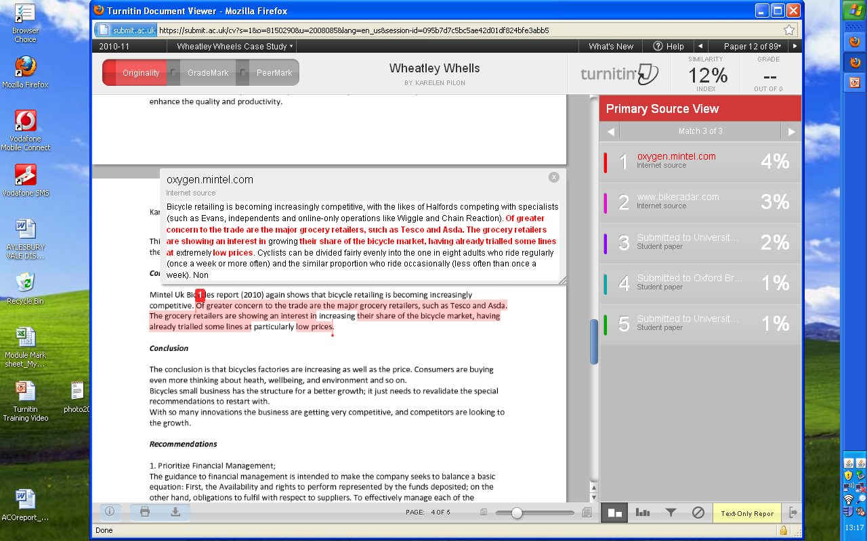
Notes:
The absence of speech marks and a page number indicates that this is an indirect quote in which case the student should be rewording the original source without loosing the meaning. Replacing the occasional word is not paraphrasing. Replacing ‘growing’ with ‘increasing’ and ‘extremely’ with ‘particularly’ is not paraphrasing. So this is therefore problematic unless referenced correctly. Let’s look at another example….

Slide 14
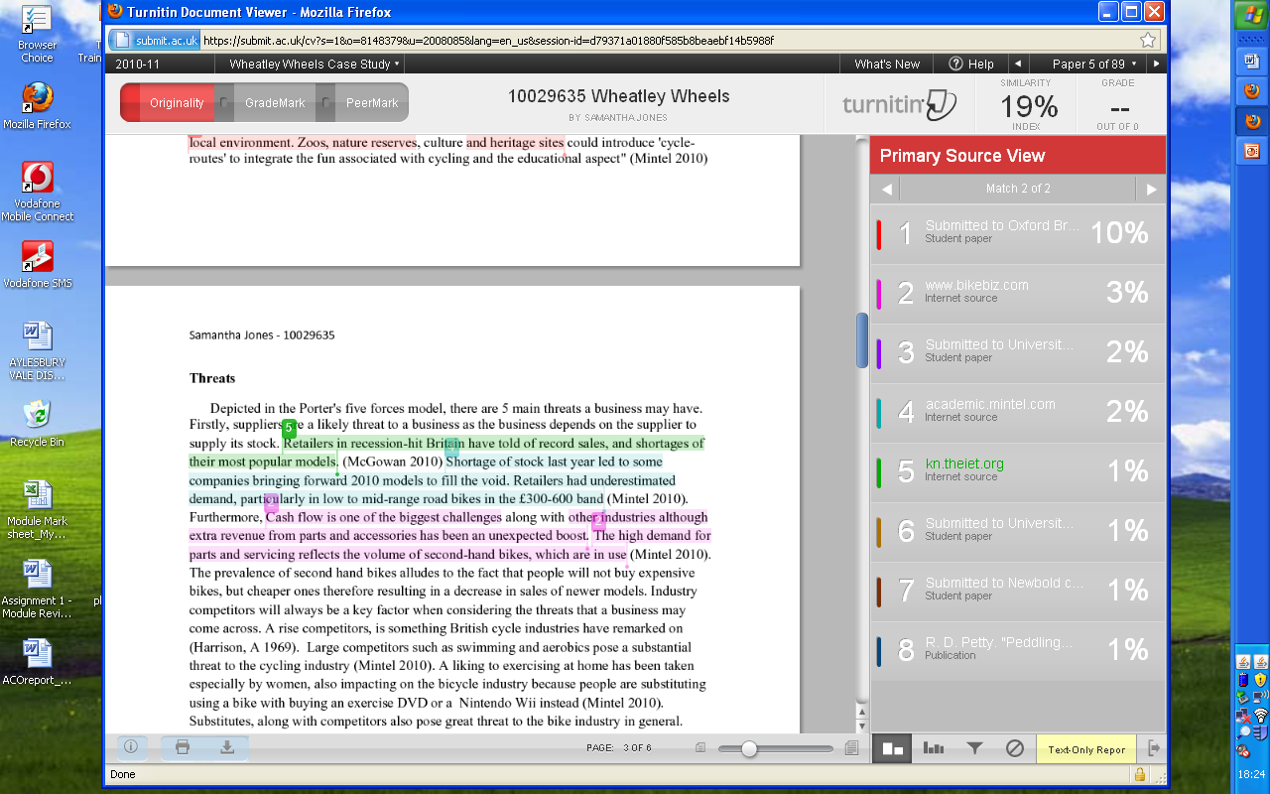
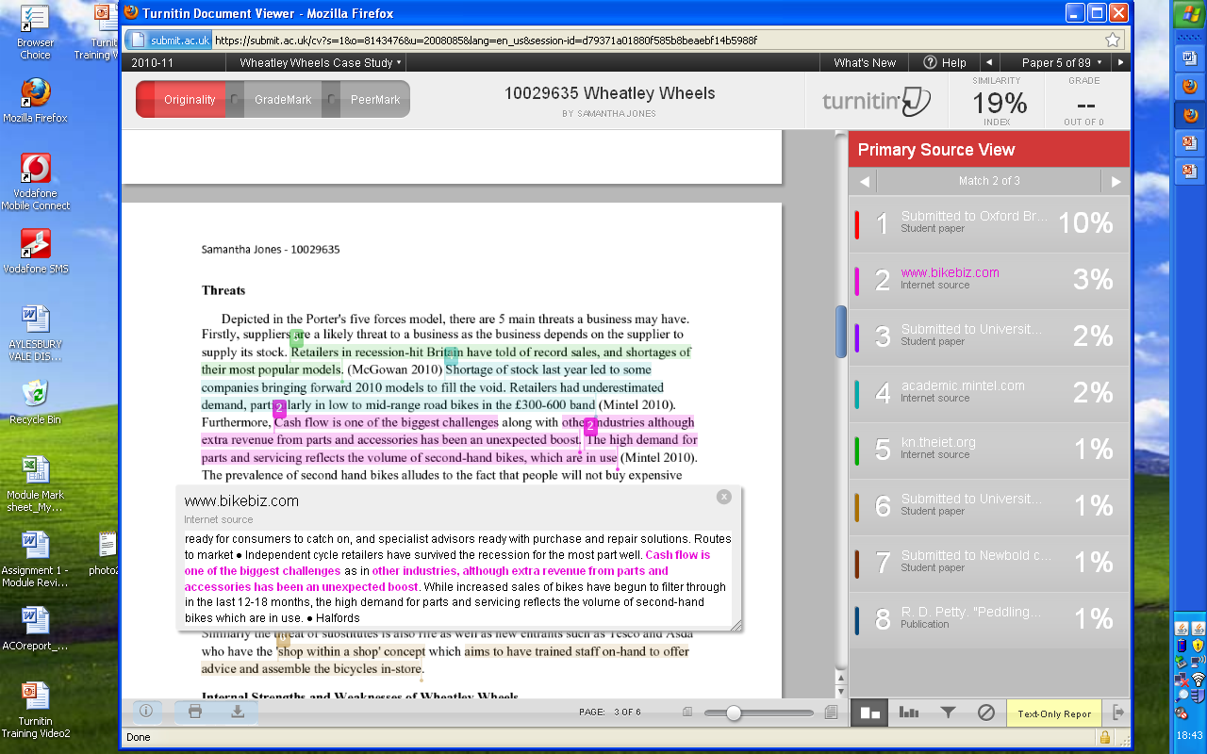
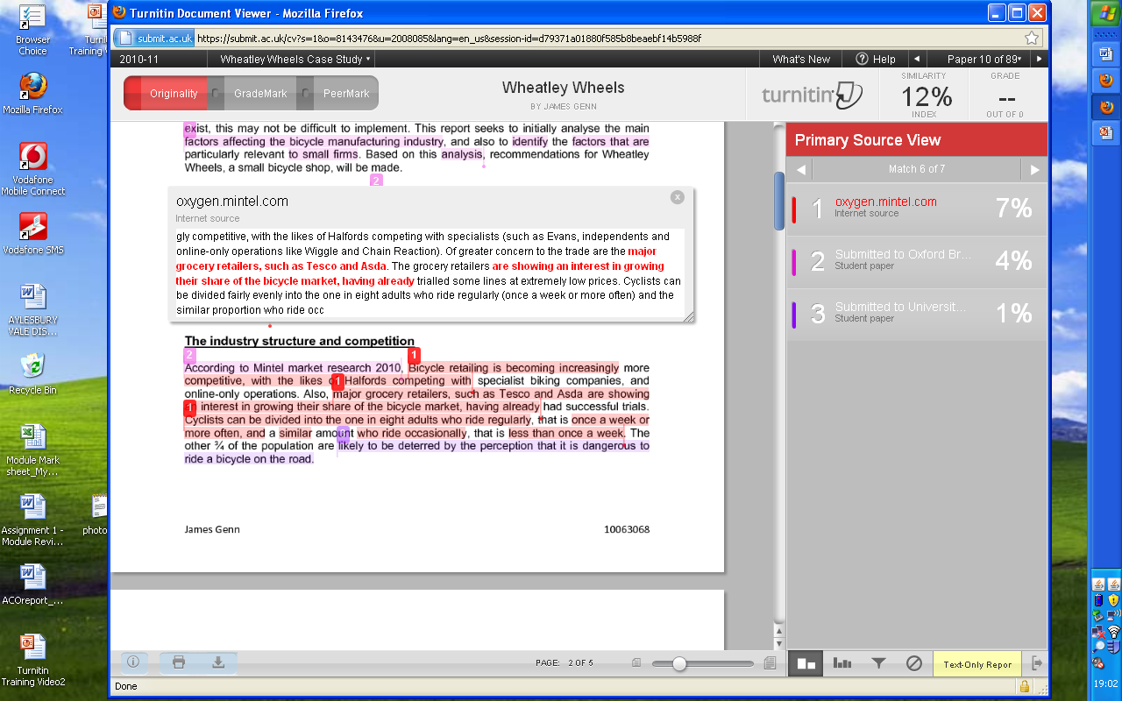
Notes:
Read the text in the student’s work highlighted in read. Compare that to the Mintel source shown in the box above – the wording is too similar for paraphrasing.

Slide 15
Other points to note
Your Similarity Index Score may be high because of your reference list
You score may be high because you are using ‘Headers and Footers’ that have the assignment title included on every page of your work
If some of your work matches the content of a ‘Student Paper’ submitted at your University or another institution, you will not be able to access the original source (i.e. the other student’s work) on screen when you view your report. Only your tutors and University will be able to request that information from Turnitin
Please try not to worry!
Notes:
Your Similarity Index Score may be high because of your reference list – if it contains sources that are stored in Turnitin or other authors using the same sources are you
Your score may be high because you are using ‘Headers and Footers’ that have the assignment title included on every page of your work. These two points are nothing to worry about and won’t be taken in to account by your tutor when interpreting your report
If some of your work matches the content of a ‘Student Paper’ submitted at your University or another institution, you will not be able to access the original source (i.e. the other student’s work). Only your tutors and University will be able to request that information from Turnitin
Please try not to worry! You have the opportunity to use Turnitin in a developmental way on a formative/draft piece of work – in other words before you submit the final version which counts towards your grades. This means that if you have accidently plagiarised in your draft piece of work then you have an opportunity to put any errors right before you submit the final version. You will then also you will know what to do in all your future assessments

Slide 16
Sources of Help
If you are unsure about any aspect of good academic writing please make contact with your tutor or Academic Adviser
There are a number of supporting guides to help you:
Cite them right – online guidance and tutorials for using Harvard referencing (including how to reference foreign language papers)
http://www.citethemrightonline.com.oxfordbrookes.idm.oclc.org/Home
The Library provides help with identifying appropriate databases and advice on successful searching strategies
http://www.brookes.ac.uk/library/index.html
UPGRADE : on-line study skills resources
http://www.brookes.ac.uk/services/upgrade/study-skills/
RADAR holds a wide range of resources to help with Turnitin e.g. How to submit a Turnitin Assignment, Dissertation Turnitin Submission Guidance
https://radar.brookes.ac.uk/radar/access/home.do
The University website (Student Regulations)
https://www.brookes.ac.uk/regulations/
Good luck with your studies!

